Slide 1

ONLINE TRANSMITTAL PAYMENT PORTAL
Department of Georgia
1

Slide 2
The Online Transmittal Process
Detachments submit transmittal(s) to the Department of Georgia through the Portal. Payments can be made by two methods, below are the fees. This is in addition to the Transmittal Payment.
Credit Card = 3% fee
EFT/ACH = $0.25 fee (less than 1/3rd the cost of a stamp)
We use EFT Corporation to process the transfer of transmittals and payment
gateway
Detachments will also be able to submit ROI's, NOD, and other forms through the portal.
2

Slide 3
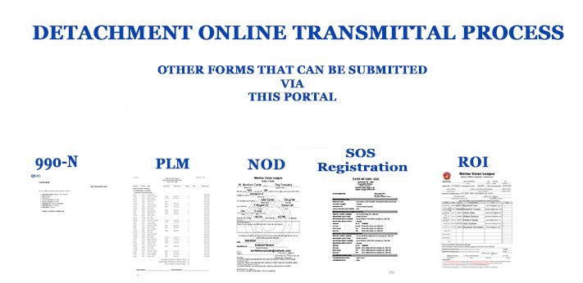
Transmittal Submissions - Electronically
3

Slide 4
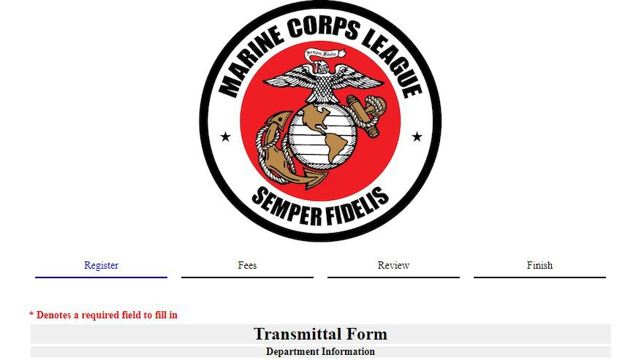
Transmittal Submissions - Electronically
Detachment
Paymaster Can input Some basic information, upload the transmittal & pay online

Slide 5
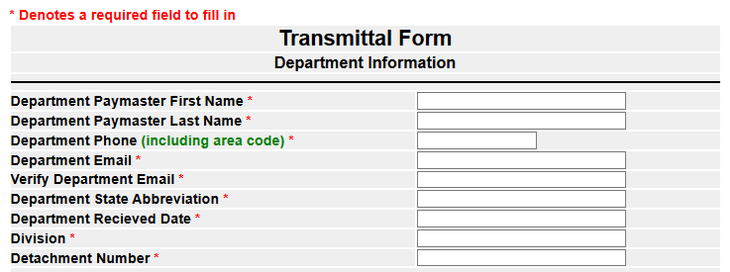
Transmittal Submissions - Electronically
Add Detachment Paymaster
Information

Slide 6
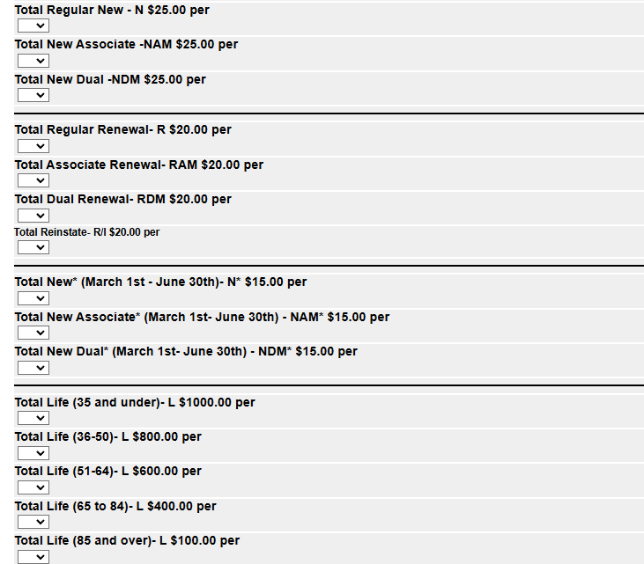
Transmittal Submissions - Electronically
Enter count for each group on transmittal
Rate includes National & Department Dues Combined
New Members
Renewals
Partial Year
Life

Slide 7
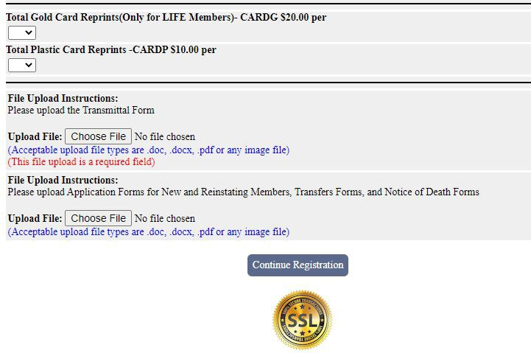
Transmittal Submissions - Electronically
Gold Card and Plastic Card Reprint
Upload Transmittal File
Upload Application, Transfer, & Notice of Death Forms
Note: PDF Files are Preferred
Click Continue to Proceed to the Next Step

Slide 8
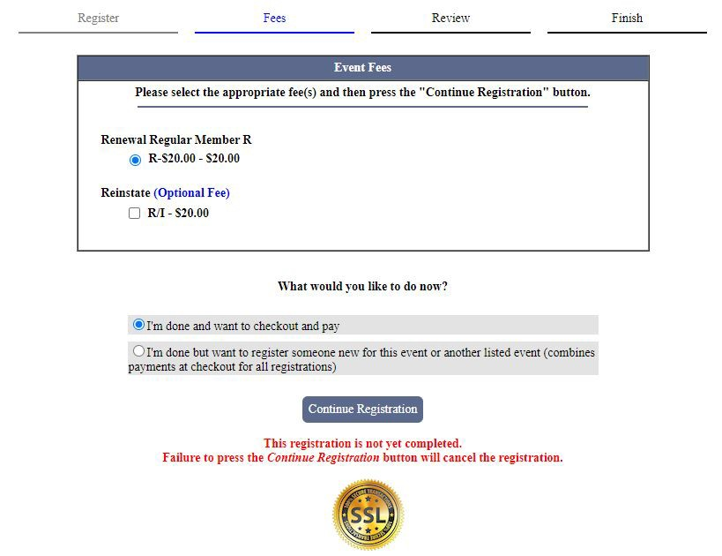
Transmittal Submissions - Electronically
Review for accuracy
Ready to check out And Pay
OR
Add another Transmittal to combine payment

Slide 9
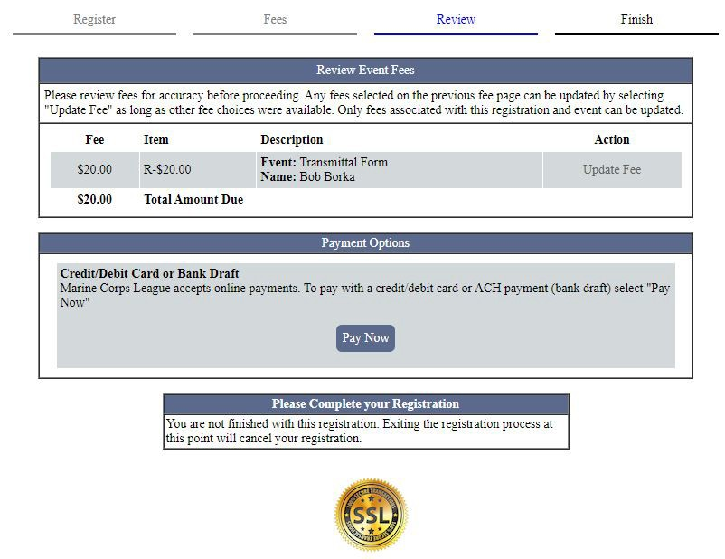
Transmittal Submissions - Electronically
Review all fees to your Transmittal
Move to next step

Slide 10
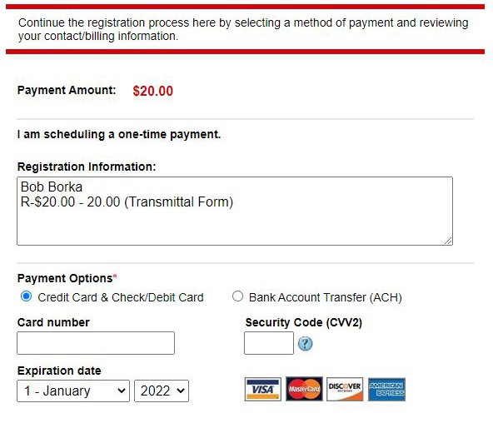
Transmittal Submissions - Electronically
This will be the Paymaster
& All Payments by type
Payment Options
1 Credit or Debit Card

Slide 11
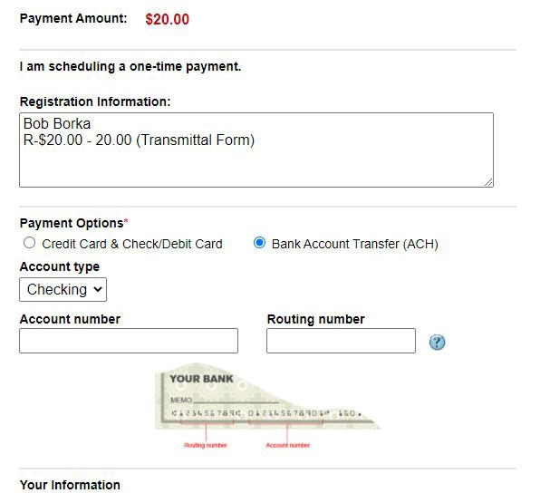
Transmittal Submissions - Electronically
Option 2
Bank Acct Transfer ACH
The info is on the bottom of the check

Slide 12
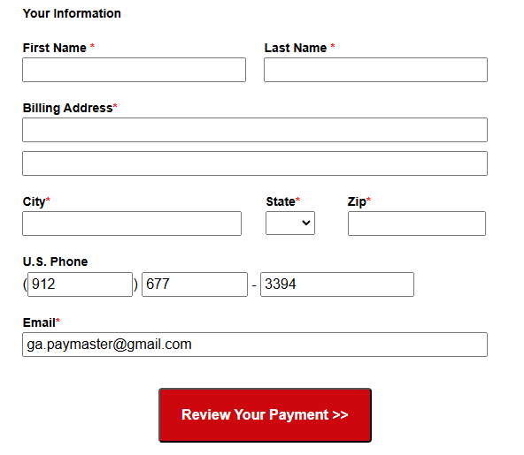
Transmittal Submissions - Electronically
Enter all information
If the info is correct click “Review Your Payment”

Slide 13
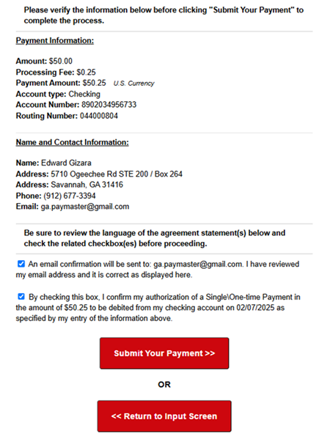
Review your transmittal & payment details
If correct click each box to confirm information and payment authorization
If everything is correct click “Submit Your Payment”
Otherwise Click
“Return to input screen”

Slide 14
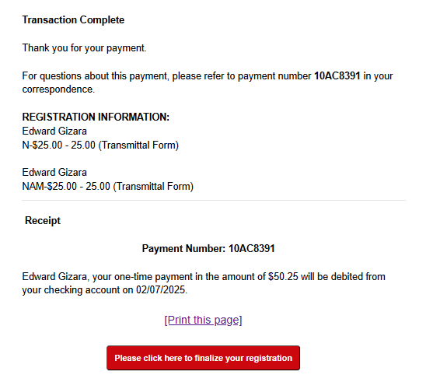
Transmittal Submissions - Electronically
Congratulations,
Your transaction is complete
Record your “Payment Number on your Transmittal
Print this page for your files,
then click “Please click here to finalize your registration”

Slide 15
Transmittal Submissions – Electronically If everything processes properly, you will receive an email that your Payment & Transmittal have been received. If you have any Questions or Issues, please contact Edward Gizara, Department Paymaster ga.paymaster@gmail.com (912) 677-3394
12

