Slide 1


Recruiting
Volunteerism
Retention
Building and Sustaining Success

Slide 2
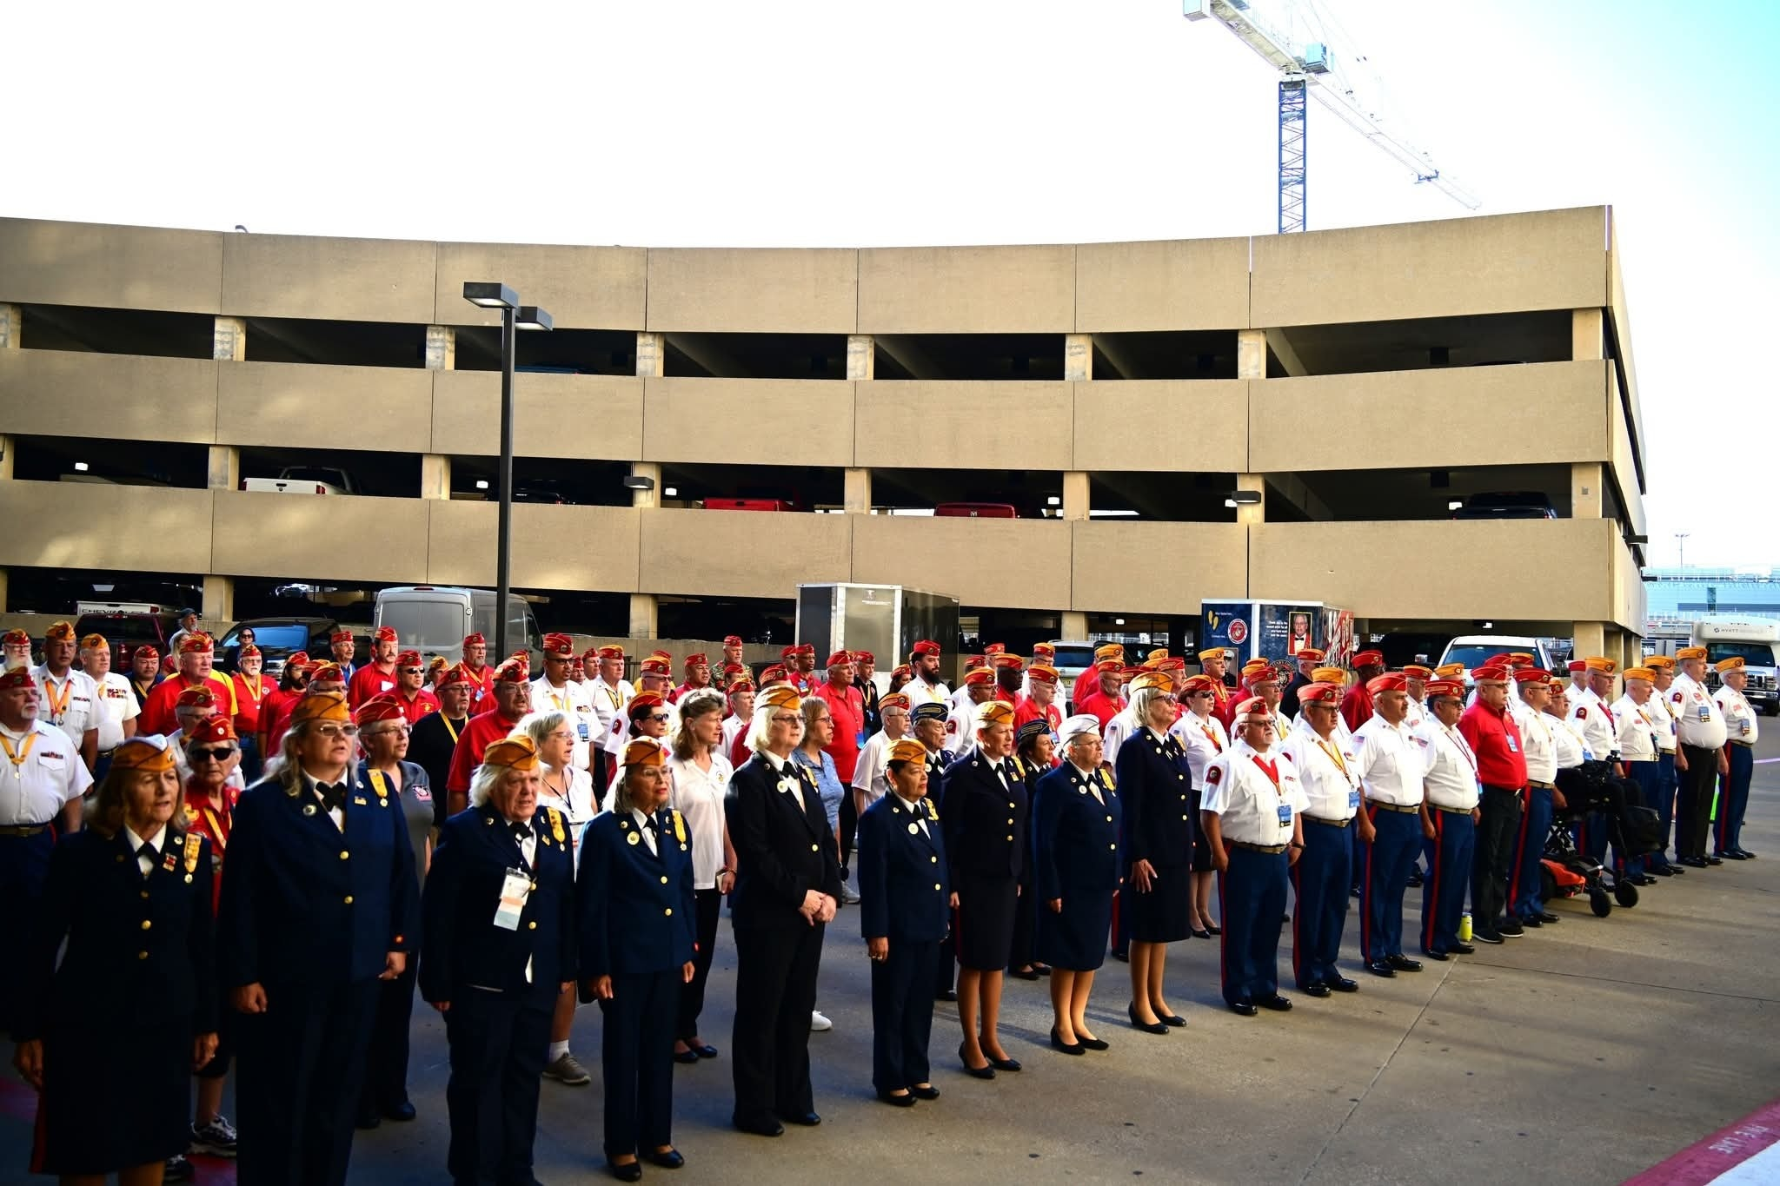

Discussion
01
Volunteerism
Mastering the Essential 3 R’s – Recruitment, Recognition, Retention
02
03
Notes:
2024-25 1798 – Avs Question for the audience – Name three leadership qualities you bring to the Young Marines- write them down and circle the MOST important to you. The average volunteer hour is worth 34.79. check your state for the actual amount independentsector.org

Slide 3





Role of Volunteers in an Organization
Volunteers have a vital role in an organization, including:
Supporting Organization Operations
Counseling
and
Education
Fundraising and Resource Collection
Providing Emotional and Social Support
Building Relationships and Networks

Slide 4
Why do people volunteer?
Values-driven
Make a positive impact on the community.
Helping others.
Supporting a cause.
Social
Connecting with others.
Networking.
Career
Gaining experience.
Personal Enhancement
Improving skills.
Feeling a sense of purpose.
Notes:
Mission – Prepare, train, equip, praise/support/value, learn about their talents, grave to take a break or leave, ask for a commitment, rotate opportunities. Volunteers are INVESTORS in your organization and address tjem with gratitude. Ask/Listen to their suggestions for solving problems

Slide 5
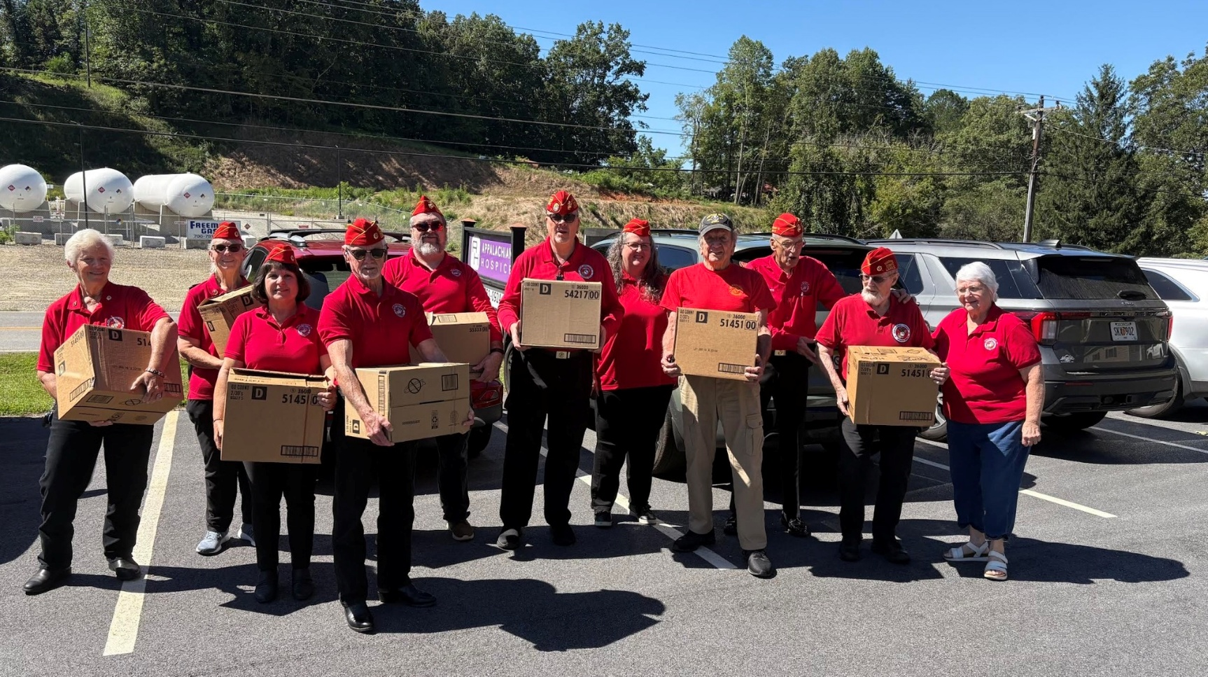
Who is Volunteering?
Sept 2022 – Sept 2023
Only 28.3% of U.S. Residents (5% )
Ages between 35-54
64% women / 36% men
Higher levels of education
Notes:
Post Pandemic - Top states in – Utah, Vermont, Minnesota, Nebraska, Kansas, So Dakota. In Connecticut, Montana, Dc and Oregon the percentage of vol rate is over 35%
We must remember the Volunteer Opportunities field is crowded.

Slide 6
Impact and Value
Hours and Economic Value (2022-2023)
Nearly 5 Billion hours.
$31.80 per hour nationwide.
Economic value approx. $167.2 billion.
Health and Career Benefits
Improved health.
Lower stress levels.
Better chance of employment.
60% of hiring managers view volunteerism as a valuable asset.

Slide 7
Other Benefits of Volunteering?
Opportunity to make a real difference and be part of a team that directly impacts the community.
Network with other professionals and volunteers who share the same goals.
Gain valuable training and experience that you can use in your career and personal life.
Notes:
Deloitte report—2024 Workplace volunteer program impact—positive. Experience and connection to employer and colleagues boost their fulfillment and purpose and strengthen their relationship to the community. Improved professional skills, including the fact that an employer provides paid time off to volunteer. This connection to volunteerism has a ripple effect and has led to 90% of employees volunteering in other organizations outside the workplace.

Slide 8
Volunteer Recruitment Strategy
Planning!
Identify Who You are Looking For!
Plan your strategy.
Know the organizational message.
Local and regional training.
List volunteer roles/duties.
Profile – Create your ideal volunteer profile. Ask other volunteers.
Who is going to be a good fit and stay with your organization long term?
This is who you are marketing to.
Get the Word Out!
Make it Easy!
Advertise - Develop campaigns.
Target your audience based on the profile you created.
Make it simple but eye-catching.
Potential volunteers fill out a form to express their interests and skills.
Plan for communication/follow-up.
Notes:
Internal doctrine and program support from Young Marines - Volunteermatch.gov/Idealist www.volunteer.gov Independentsector.org, Strategic Volunteer Engagement
Social Media, Open House Word of mouth, existing volunteers, nonprofit volunteer centers/websites, AARP

Slide 9
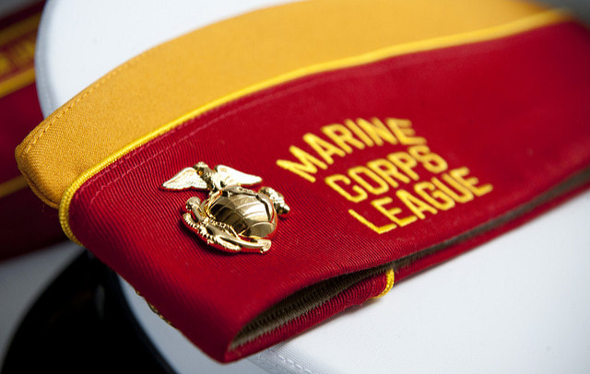
Who are you looking for?
Check the Criteria
Useful Skills
Good communication
Ability to work in a team
Leadership and time management
Attitude and Commitment:
Commitment to organizational goals.
Empathy and sense of responsibility towards the community.
Desire to learn and grow.
Time Availability:
Volunteers can be involved full-time or part-time.
Notes:
Vol must see & understand of how their contribution affects the lives of those they will be motivated to come back week after week What jobs do you need filled in your organization

Slide 10
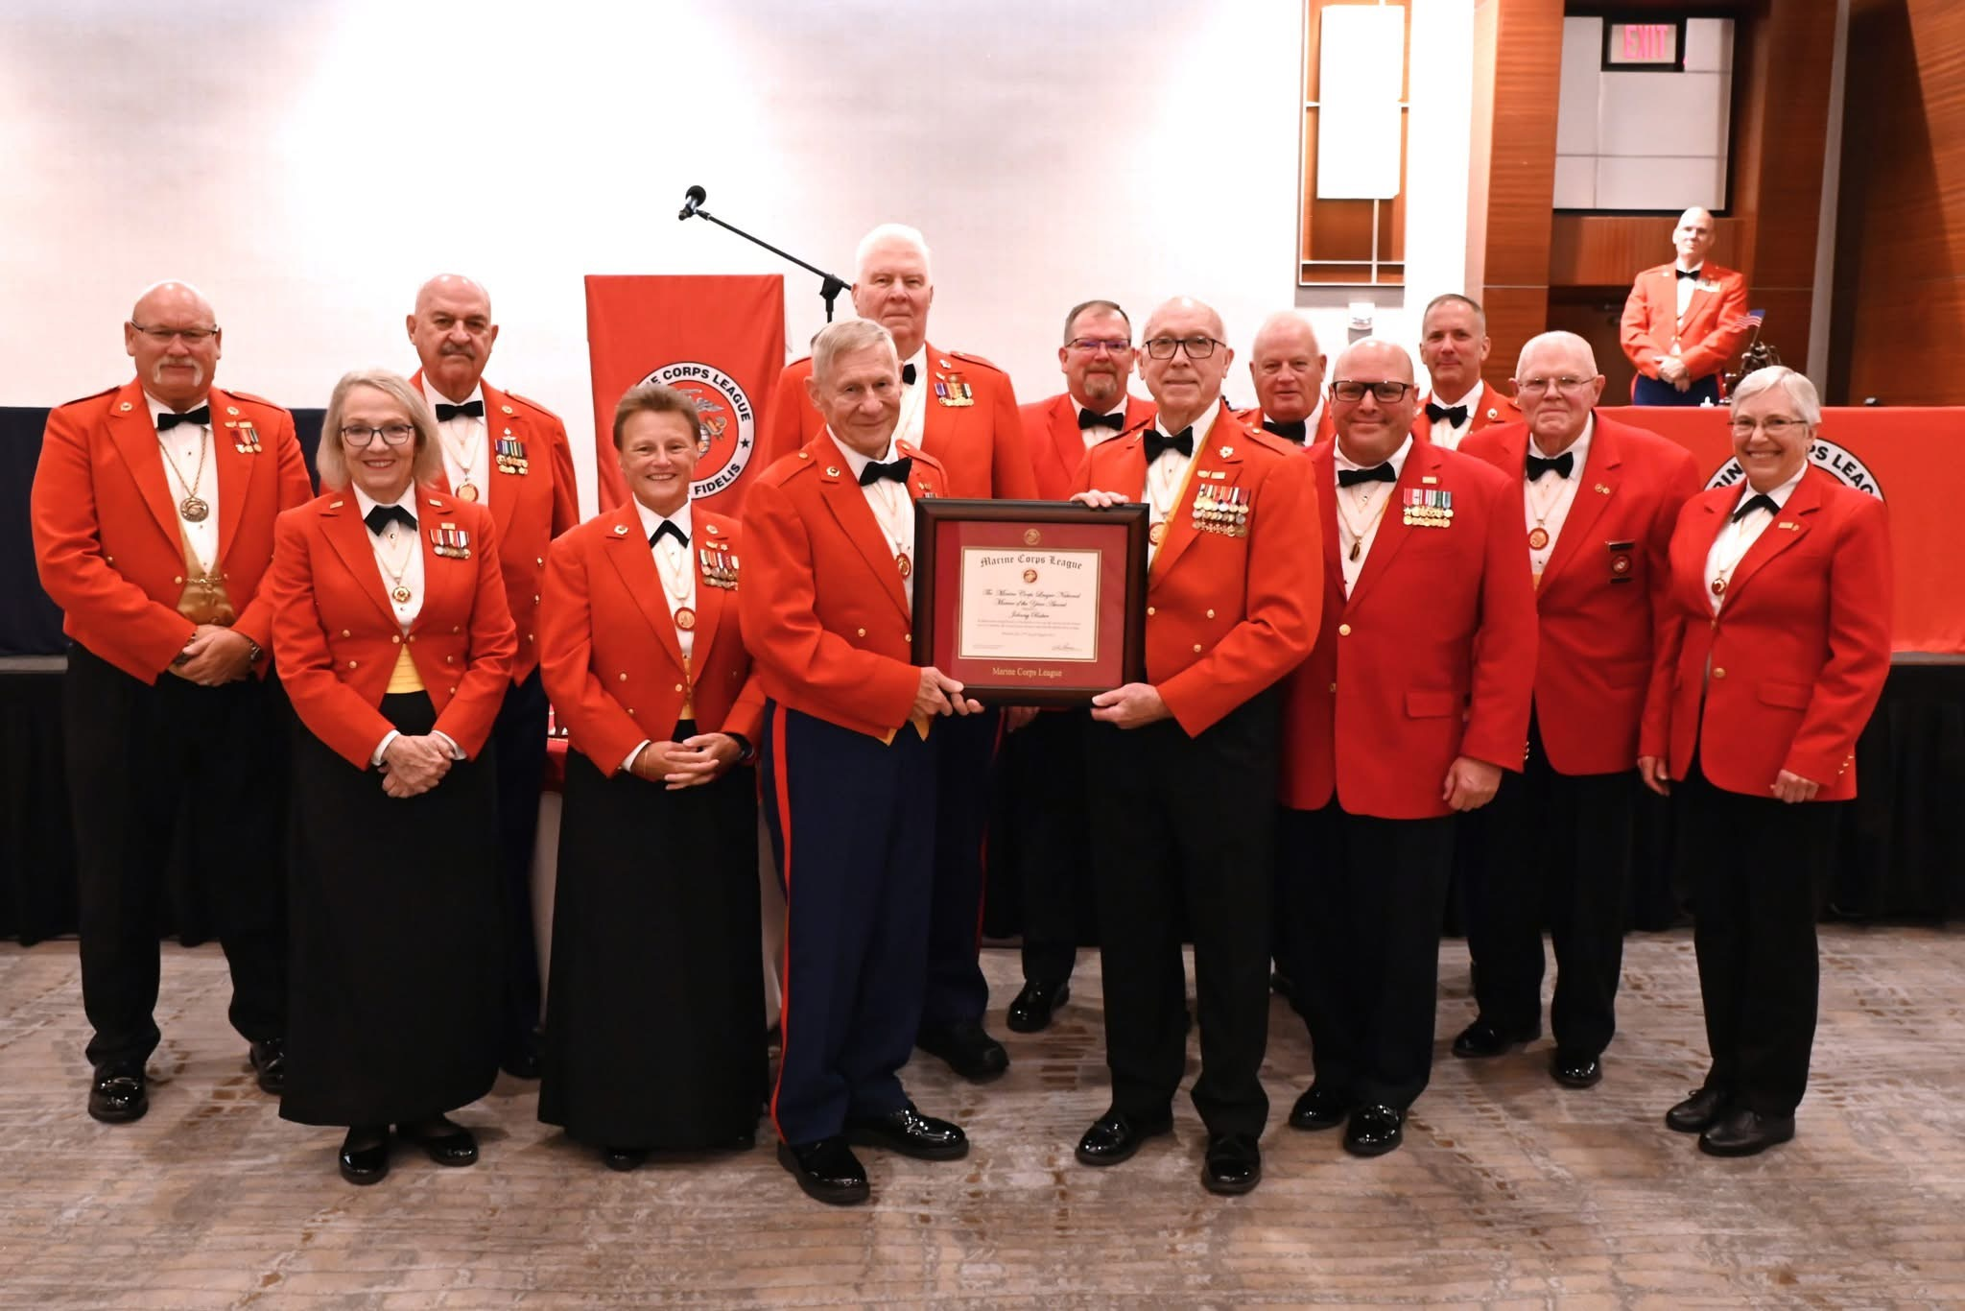
Recognition
Honoring Contributions
Celebrations
Awards
Hours/Years of Service
Swag
Personal/Group Thank You
Shout Outs
“Grace” for the unexpected “mess-up”

Slide 11
Improving Volunteer Retention
Maintaining Volunteer Engagement
Clear Expectations
Conflict Resolution Skills
Annual Program Evaluation
Appreciation/Motivation
Foster organizational belonging
Training and Leadership Development
Notes:
Mission – Prepare, train, equip, praise/support/value, learn about their talents, grave to take a break or leave, ask for a commitment, rotate opportunities. Volunteers are INVESTORS in your organization and address tjem with gratitude. Ask/Listen to their suggestions for solving problems

Slide 12
Rate Your
Motivational Practices
Tap into the volunteer’s motivational drivers
Give regular feedback
Give regular rewards and recognition
Offer special privileges or incentives
Send volunteers to conferences
Provide on-the-job vocational training
Be available to volunteers
Give public affirmations
Have fun
Positive gossip
Huddles
Thank families of volunteers
SELF CHECK –UP DO YOU?
Score
4- All of the time
3- Most of the time
2- Occasionally
1- Never
Notes:
Audience – activity – Where do you score in motivation mostely 3-4 – you are doing well – mostly 2’s time to consider changing your practices. Challenge yourself to do something with any of those 1’s

Slide 13
Life Events/Busy Schedules
Feeling Under Appreciated
Unpleasant Experience
Loss of Interest
Burnout
Why Do
Volunteers Quit?
Notes:
Other reasons people quit – reality vs expectation differences, veteran vols have an insiders group and new folks are not invited or welcome, suggestions ignored, atmosphere is impersonal, tense or cold, physical environment did not support the efforts, no one smiled a them and #1 they were underutilized

Slide 14
Future of Volunteerism
2023
Volunteering on the Rise!
Millennials (27-42) most significant GAIN.
People who identify as Asian, Native Hawaiian or Pacific Islander and Hispanic.
Those with less than a high school education.
Family income below $25K.
2025
UGA Study published in 2025 suggests Americans are volunteering less.
Possibly caused by economic uncertainty and social unrest.

Slide 15
Recruitment:
The Next Generation of Volunteer Leaders
Different strategies – Emphasis in social media platforms and trends.
Communication-centric
Training:
Incorporating work-life balance
Skills-based – basic to advanced training
Use evaluation and consistent feedback
Retention:
Emphasis on gaining various transferable skills and leadership opportunities.
Programs addressing community needs and causes important to the next generation.
Notes:
Empower that everyone is a leader and teacher/trainer in an organization. Learning styles relation to training. Invest TIME to increase success. Today’s leader are influencers. They want to leave a legacy and serve a greater purpose. Teach + develop= Impact!

Slide 16
Thank You!
Questions?
Notes:
Audience – look back at that list of leadership qualities you possess – building your volunteer planning, recruitment, recognition and retention GOALS

