Slide 1
Filing your IRS 990-N Form
Your Gross Receipts must
be $50,000 or Less

Slide 2
Click the following Link to enter the IRS System to file your 990-N form
Click Here to go to the IRS

Slide 3
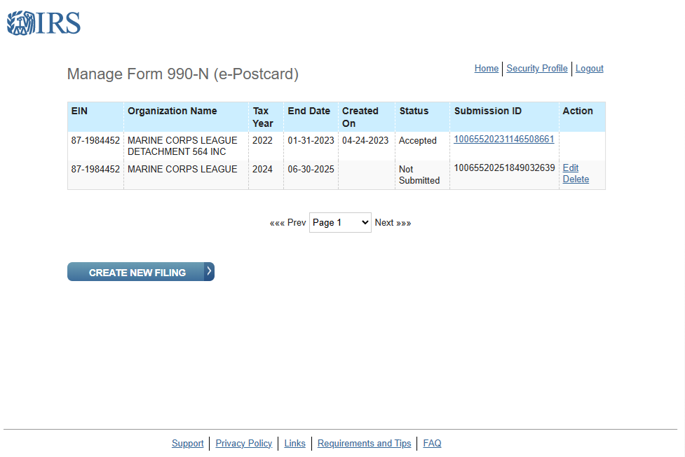
Select “Create new filing

Slide 4
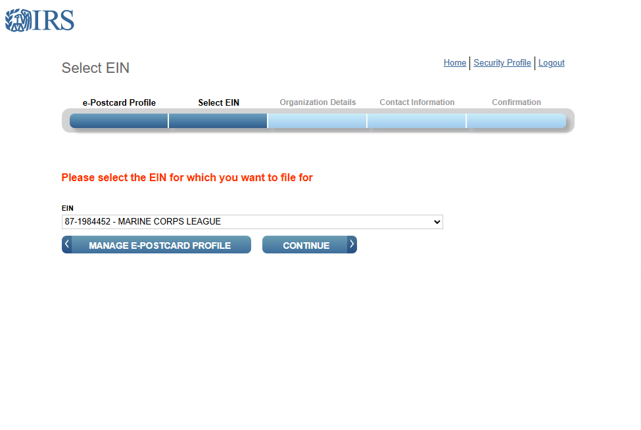
Select your ein from the dropdown list

Slide 5
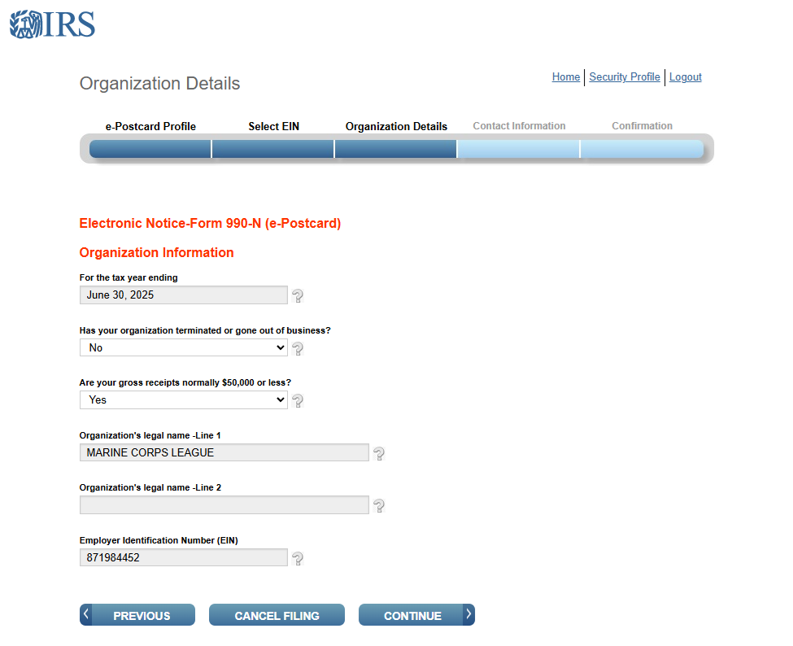
Answer the two questions
1. Has your organization terminated or gone out of business?
The answer should be no
2. Are your gross receipts normally $50,000 or less?
The answer should be Yes click continue

Slide 6
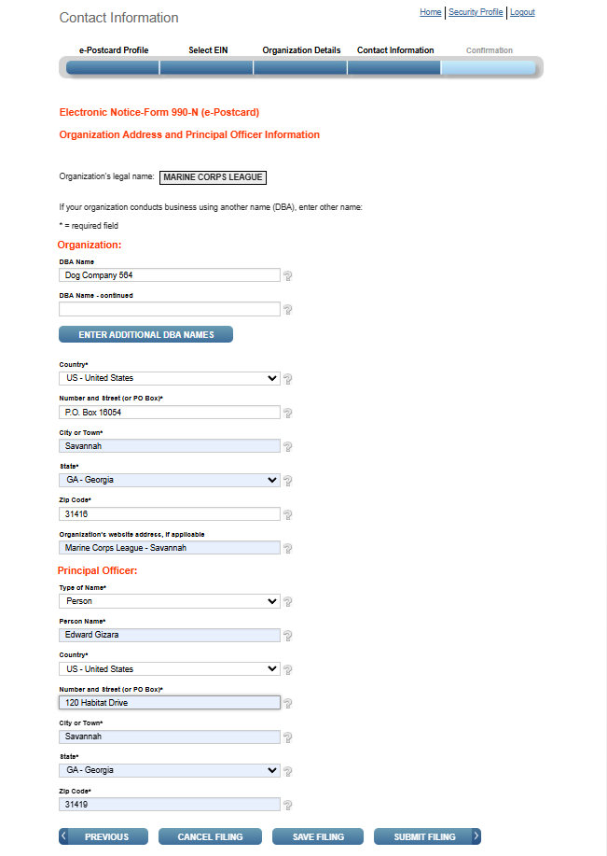
Complete the information on the contact form, then click submit filing

Slide 7
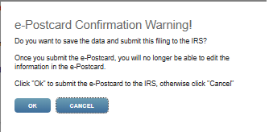
A pop-up screen will appear click “OK”

Slide 8
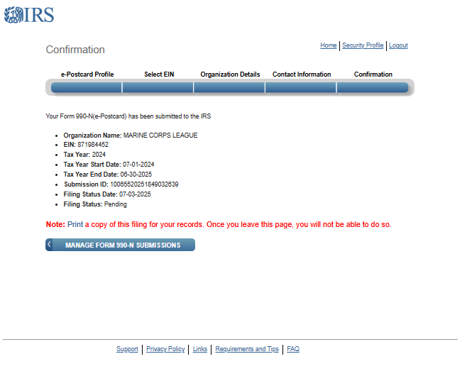
A confirmation will appear ensure that you print this form to a PDF file
Then Click Manage Form 990-N submissions

Slide 9
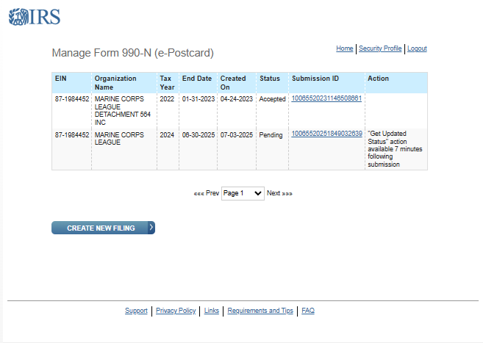
On the manage form 990-N you will see that it says
“get updated status” action available 7 minutes following submission do not close this page – wait seven minutes and refresh your screen “F5”
This will change to “Update Status.” Click it, and the status will change to accepted

Slide 10
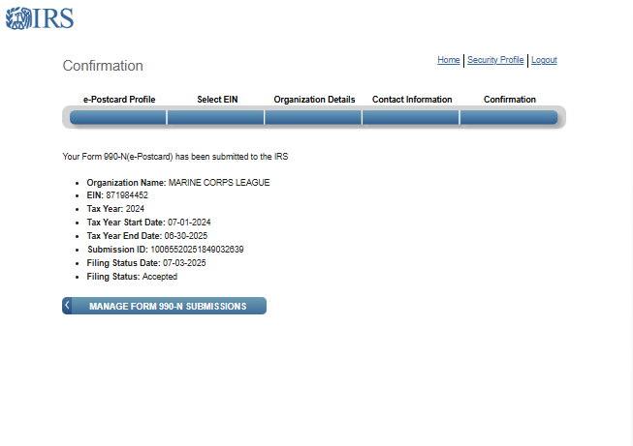
Print this form to pdf and email both forms through the Paymaster Portal

