Slide 1
DETACHMENT PAYMASTER COURSE

Slide 2
COURSE OUTLINE
THIS Course will Cover
Job Description, Duties, Responsibilities, Skills and Qualifications for the Detachment Paymaster
Membership Processes including New Members, Transfers, NODs
Membership Transmittal Form(s)
Member Database Overview
Rosters & Roster Maintenance
PLM Audits
Filing 990 Tax Returns
Secretary of State Annual Filings
Final Recommendations

Slide 3
MARINE CORPS LEAGUE
POSITION DESCRIPTION
DETACHMENT PAYMASTER
(Elected or Appointed Annually) Position Overview
The Detachment Paymaster is a required position within the Marine Corps League. The easiest and closest label description of the position is that of CFO – or Treasurer – much like one would find in any for-profit company. The Paymaster receives all monies, pays all bills, manages all bank accounts and investments (if exist), submits membership transactions and PLM audits to National, files IRS 990 returns, prepares/submits financial reports and maintains all financial records. Paymaster and Commandant are insured under the National organization’s bond (see N-APs Section 6035.)

Slide 4
MARINE CORPS LEAGUE
POSITION DESCRIPTION DETACHMENT PAYMASTER
Principal Duties and Responsibilities
Receives all monies paid to the Detachment and pays all bills and/or issues checks for all contributions paid by the Detachment.
Prepares and submits all membership Transmittals.
Prepares and submits the annual PLM Audit.
Prepares and submits the annual IRS 990 filing.
Prepares and Submits SOS filing. A copy is to be sent to the Department Paymaster.
Prepares and maintains all financial records and issues reports based on the Detachment’s financial records.
(New) Maintains membership records in the Portal and is the Detachment’s POC (point-of-contact) to National for maintenance of the Detachment Roster data in the membership database.

Slide 5
MARINE CORPS LEAGUE
POSITION DESCRIPTION
DETACHMENT PAYMASTER
Desired Skills and Experience
Associates can serve if Paymaster is an appointed position
Good communication skills both verbal and written
Able to organize and present information clearly and concisely
Good understanding of modern banking processes
Good computer skills including web transactions and spreadsheets
Knowledge of basic accounting practices and software helpful
Must have access to a computer and printer and have/use email
Social media experience very helpful but not mandatory
Able to focus on issues to fix problems and not assign blame

Slide 6
MARINE CORPS LEAGUE
POSITION DESCRIPTION
DETACHMENT PAYMASTER
Additional Comments
Detachment Paymasters tend to stay in their positions for a long time (many years) simply because of the type of job that it is. Some members don’t have the skills or interest or just see it as too hard. This typically leads to one or a combination of several situations:
Detachments are stuck when the Paymaster leaves or passes
Paymasters are stuck and become entrenched
Detachment Officers get complacent and stop auditing or checking on the accounts. When this is the case, money can “disappear” overnight and result in all manner of problems
The only real way to prevent any of these is transparency and diligence in not taking the Paymaster or the job for granted

Slide 7
MARINE CORPS LEAGUE
POSITION DESCRIPTION
DETACHMENT PAYMASTER
Additional Comments (Continued)
Commandants and Paymaster are both covered automatically by the bond carried by National HQ because they are the two officers charged with handling money.
If the Jr. Vice (or the fund-raising chair) or other officers are to handle funds, they can be covered by the bond if they are appointed by the Det. Commandant to this responsibility and if their appointment is communicated in writing to National HQ.
The bond carried by National HQ insures the Detachment against criminal acts committed by the officers covered. It does not cover social media fraud and is not a commercial general liability policy.

Slide 8
MEMBERSHIP PROCESSES
THE PAYMASTER WILL PROCESS…
New Member Applications
Member Transfers
Member Renewals
Member Reinstatements
Members Changes of Name and/or Address
Life Memberships
PLM Audits (Annually)
Rosters received, reviewed and distributed w/in the Detachment
Except for Roster maintenance and PLM Audits, all these processes require the use of the Transmittal form.

Slide 9
APPLICATIONS
GENERAL COMMENTS
Membership Applications
Application Forms are available in the Member Library. Check the Library periodically – the forms do change occasionally to make sure the most current form is used. (Changed in 2023!)
Ensure that you use the official application From the MCL Library and incorporate information about your Detachment, your dues, benefits of membership, etc., into the application.
The form needs to be completed. Especially the type of membership, verification of service, felony question, oath and it must be signed by the applicant and the recruiter.

Slide 10
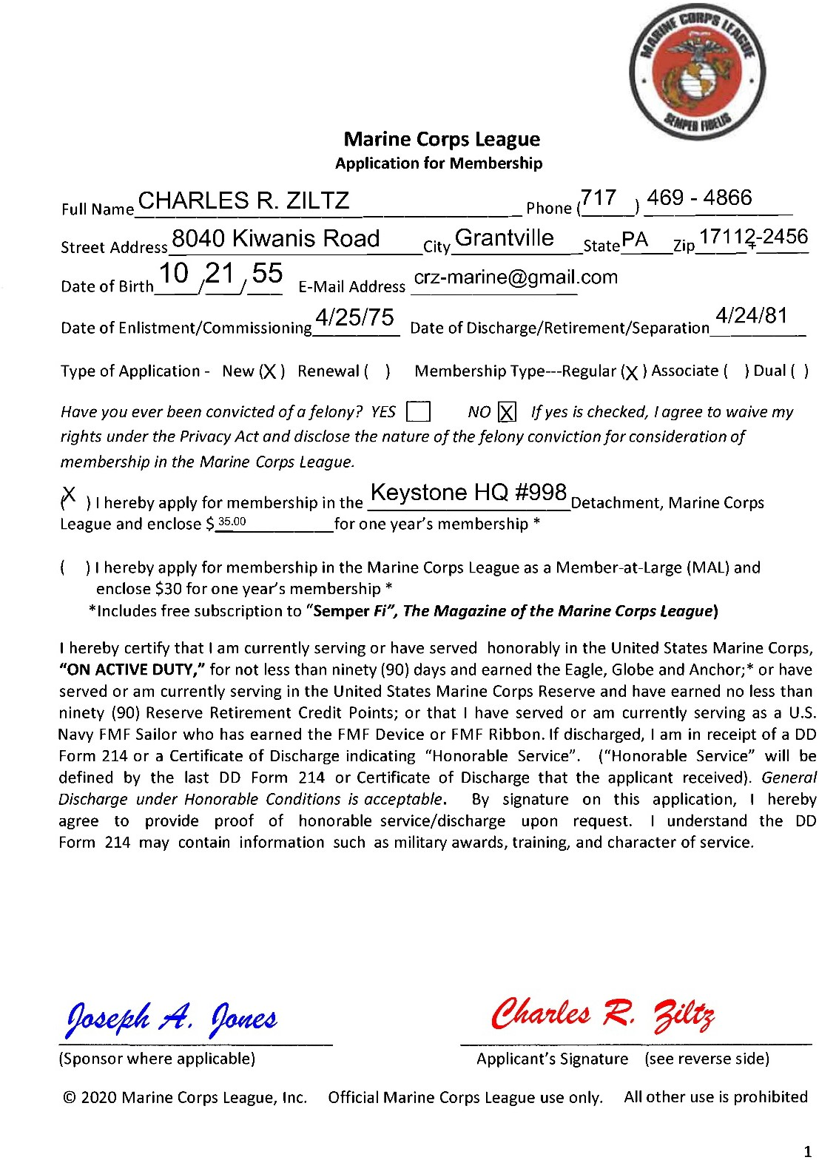
APPLICATION FOR MEMBERSHIP
This is an example of the front side of the current Application for Membership, filled out to show what must be completed.
The next three slides are enlargements of this form.

Slide 11
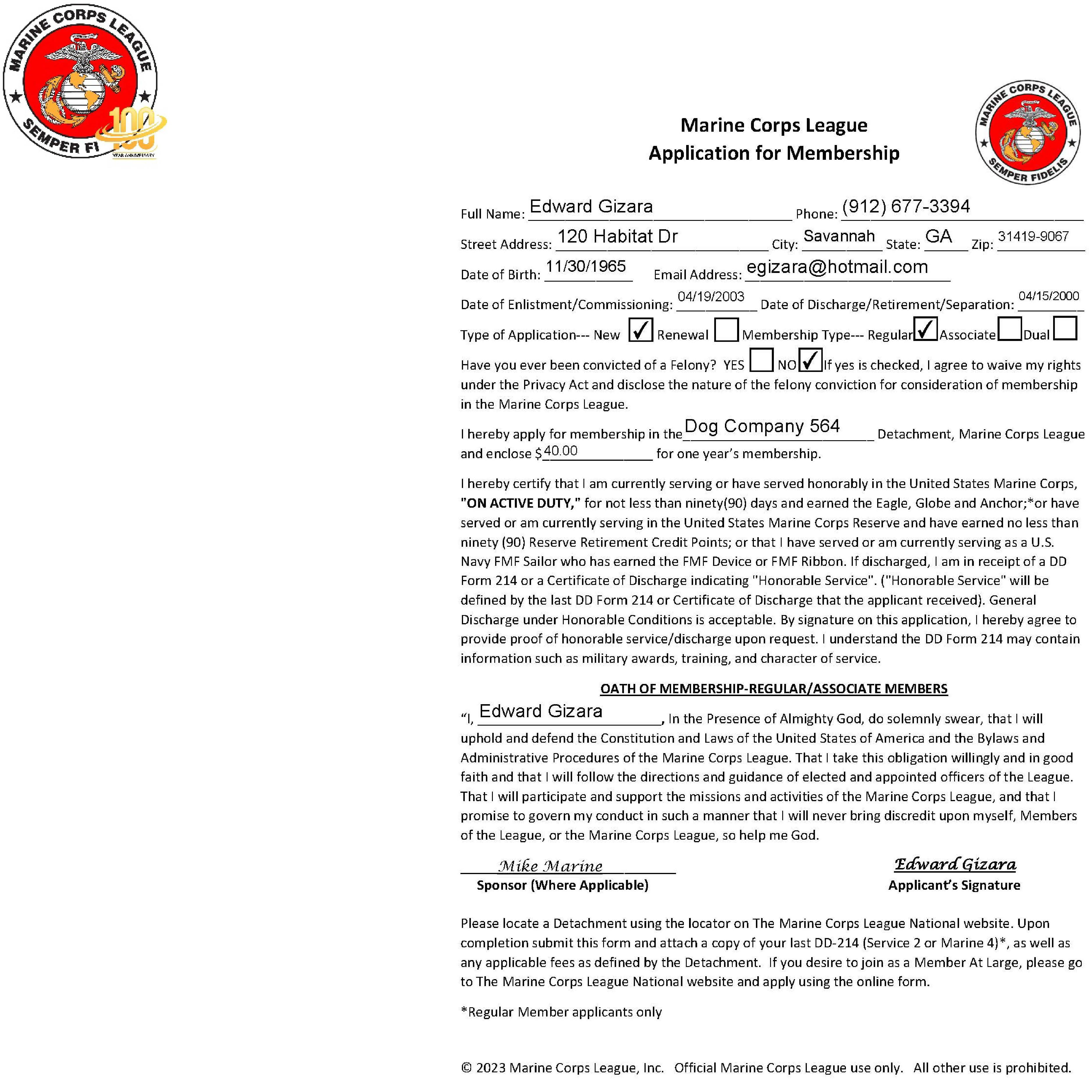
This is the most current application from the MCL Library as of this printing.

Slide 12
APPLICATIONS
ADDITIONAL COMMENTS
Membership
Detachments are the judge of their new members and if they are qualified to be members. The onus of checking a DD214 or any other documents (discharges) is on the Detachments.
Detachments should vote on new members and swear them in.
Instant disqualifying conditions.
Previous expulsion from the Marine Corps League
Convicted of any crime (not just a Felony) in which the victim of the crime was a child
Current incarceration or supervised probation for a felony or misdemeanor conviction of any crime. See Traffic Violations

Slide 13
TRANSFERS
GENERAL COMMENTS
Request for Transfer
Transfer Forms are available in the Member Library. The Transfer Form is also a fillable PDF. Check the Library periodically – the forms do change occasionally. Use the most current form.
Membership is always with a specific Detachment. Transfer is the process of moving membership between two Detachments.
Members must be in “Good Standing” to transfer. Good standing means that they are current in their dues with the Detachment they are leaving and that they owe no money, including dues.
Transfer requires both the old and new Detachment Commandants’ signatures. Transfer is not automatic - the new Detachment should vote to accept the transferee.

Slide 14
TRANSFERS
GENERAL COMMENTS (CONT)
Request for Transfer
Dual Members (members who belong to more than one Detachment) have voting rights only in one Detachment.
Voting rights can be transferred by the member at any time. To do this, sections 1 and 4 are completed by the member and submitted.
It is required, that members joining additional Detachments as dual members complete and submit a transfer form (sections 1 and 4) specifying which Detachment they desire to have voting rights. Not being clear about voting rights can lead to unexpected surprises when registering for the National or Department Conventions.

Slide 15
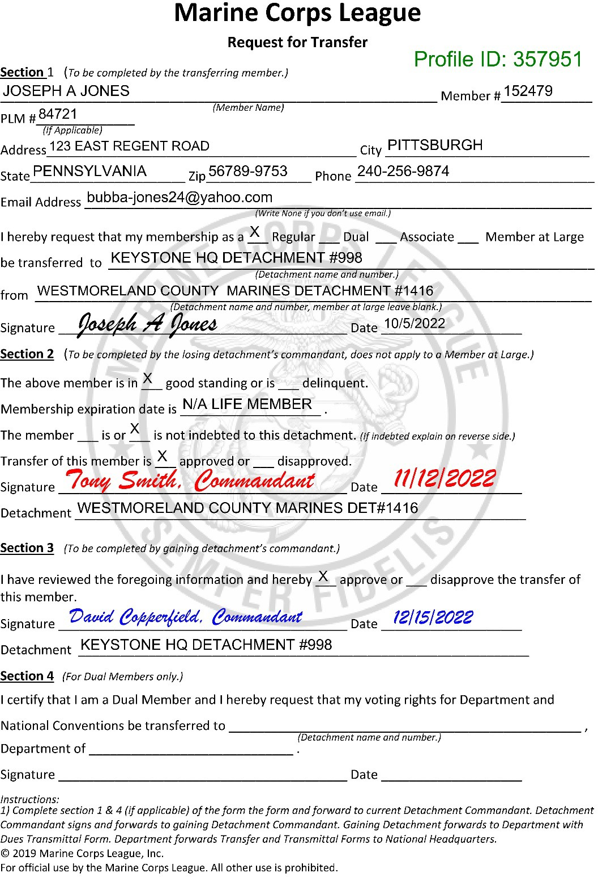
MEMBER TRANSFERS
This is an example of the current Request for Transfer form, filled out to show what must be completed for a Detachment-to- Detachment transfer of a life member.
The next three slides are enlargements of this form.

Slide 16
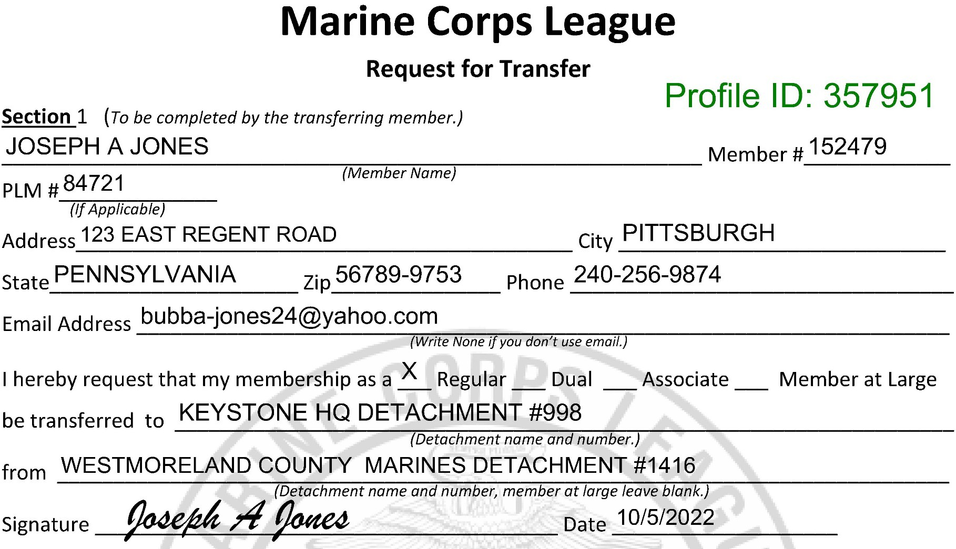
TRANSFERS
Must include the Profile ID:

Slide 17
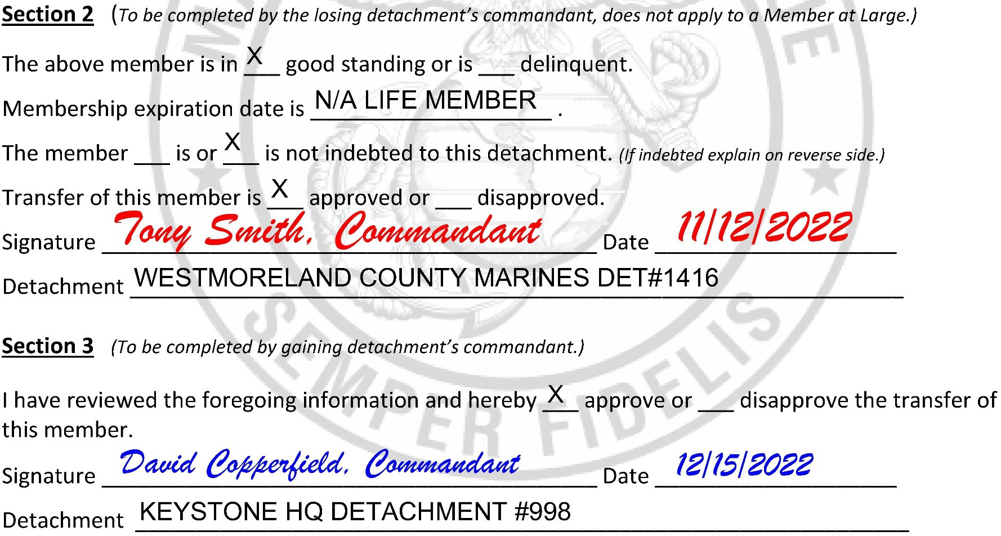
TRANSFERS
WESTMORELAND COUNTY DET # 1416

Slide 18
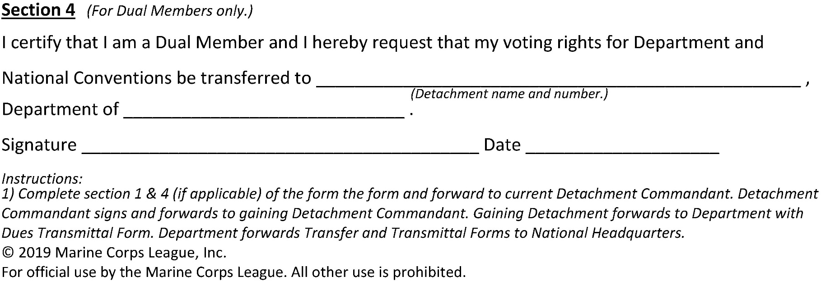
TRANSFERS
This is Section 4 of the Request for Transfer. It is only used if a current Dual Member is moving their voting rights between Detachments that they already are members of.

Slide 19
TRANSMITTALS
GENERAL COMMENTS
Transmittal Forms
Transmittal Forms are fillable PDFs and are available in the Member Library. Check the Library periodically – the forms change many times per year and without any warning.
Use a computer to complete the form, do not complete by hand
It is preferred to send the transmittal to the Department Paymaster electronically, print any copies that are needed for the Detachment records or officers.
Sign the form and include an email address that is actually used by the Paymaster. It is easier to make minor corrections by email than to send the entire package back.
Do not use staples. Ever.

Slide 20
TRANSMITTALS
GENERAL COMMENTS (CONT)
Transmittal Forms
The Transmittal form is used for ALL membership transactions. Including:
New Members (N, NAM, NDM)
Transfers (T)
Renewals (R, RAM, RDM)
Reinstatements (R/I)
Life Memberships (L)
Change of Address (COA)
Change of Name (CON)
Submitting NODs for PLM list updates (NOD)
Deletion over 2 years (D)
Gold Card Replaced (CARDG)
Plastic Card Replaced (CARDP)

Slide 21
TRANSMITTALS
TRANSMITTAL TYPES & CODES
Transmittal Codes are on Page 1
Transmittal FORM is on Page 2 (Short Form)
A Long Form Transmittal is available also. The Long Form has 20 pages total and can be used to submit 51 transactions with one Transmittal

Slide 22
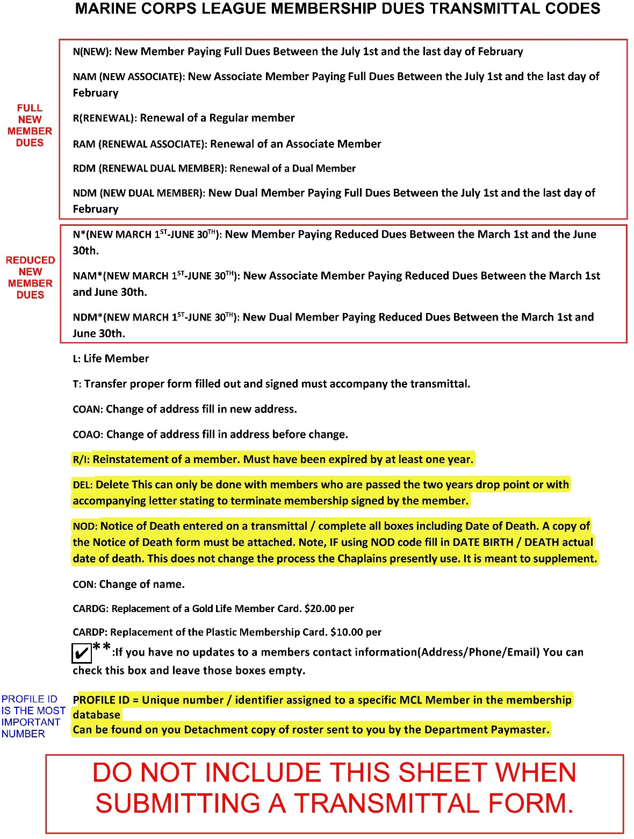
TRANSMITTALS
SHORT FORM 2021 VERSION
PAGE 1 (CODES PAGE)

Slide 23
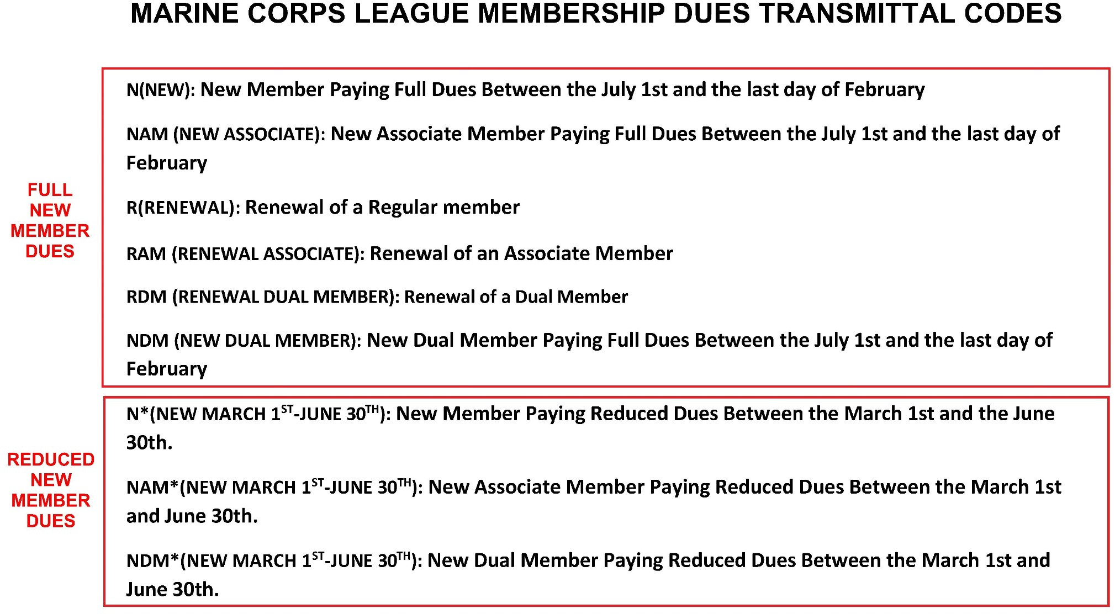
TRANSMITTALS

Slide 24
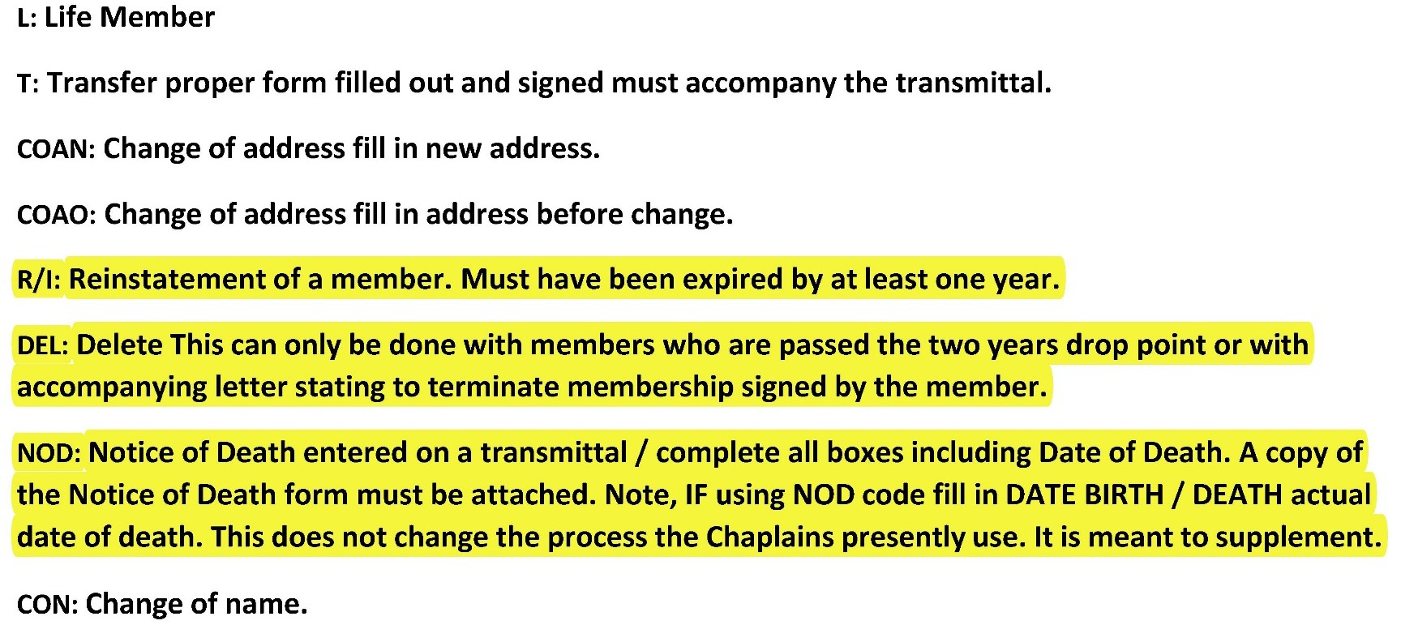
TRANSMITTALS
COAN & COAO can now be done via the Database Portal

Slide 25
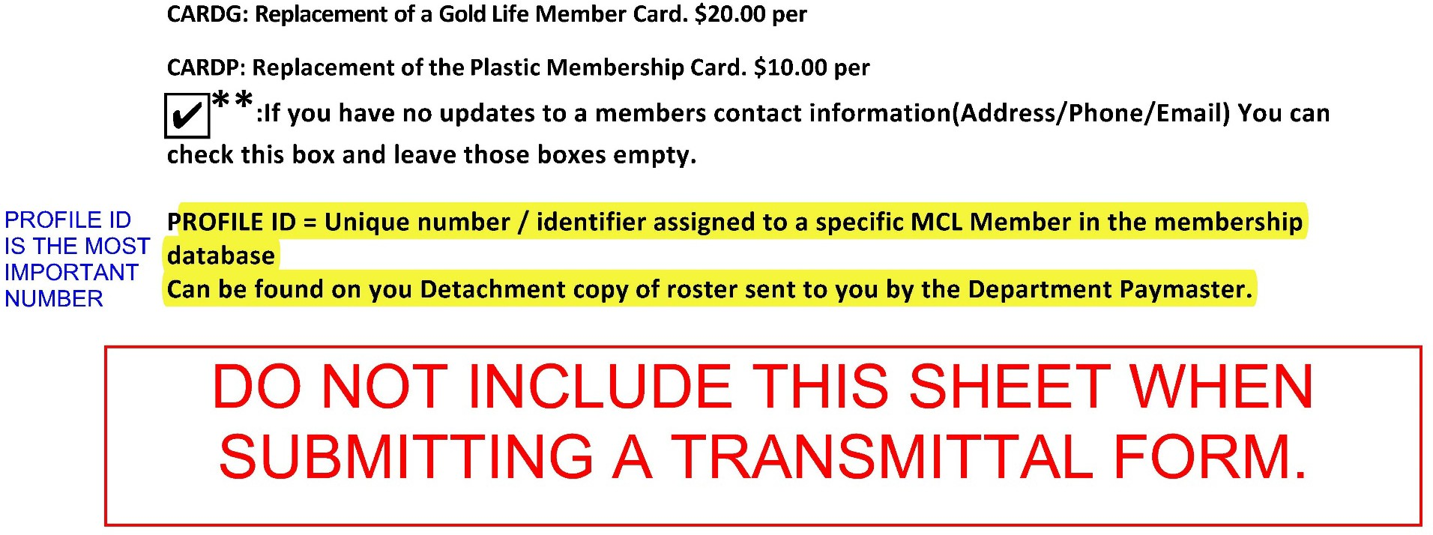
TRANSMITTALS

Slide 26
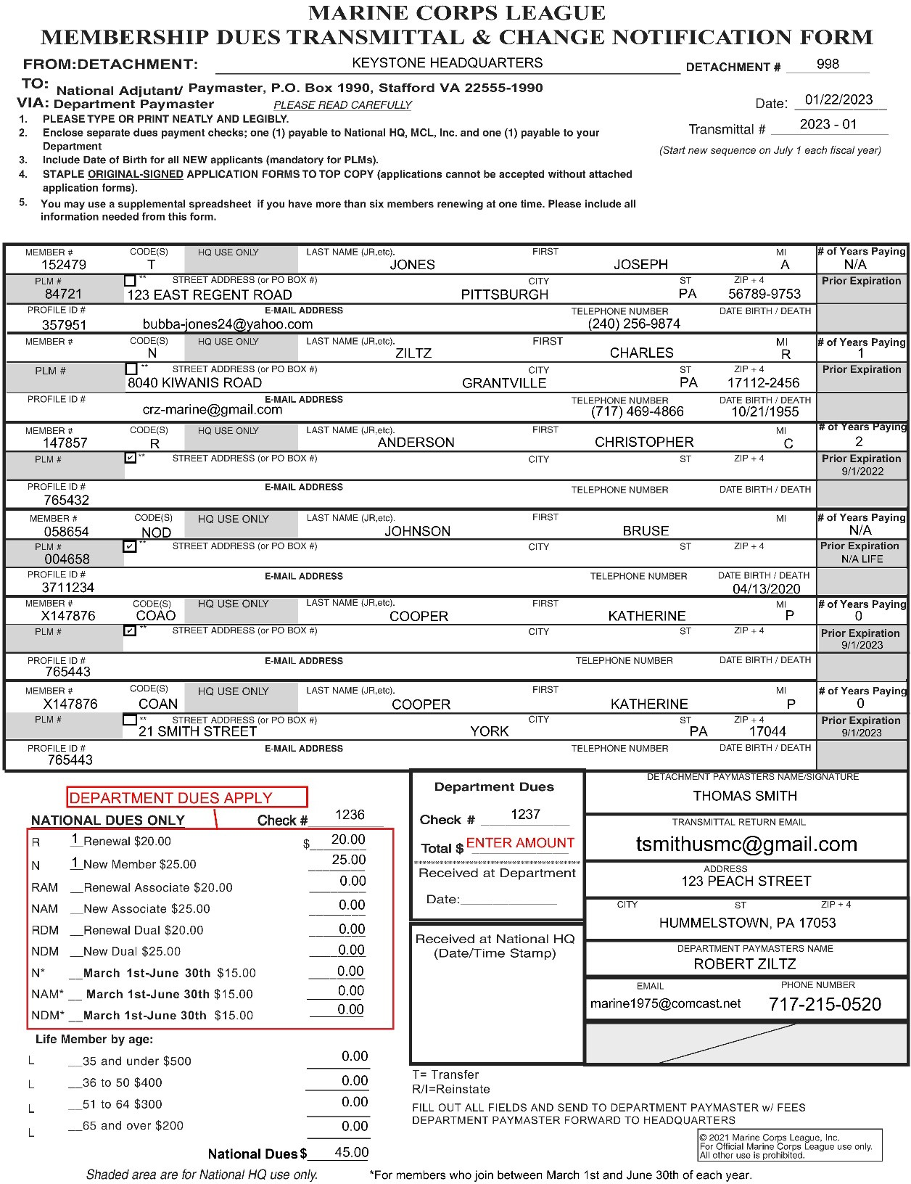
TRANSMITTALS
All members info must include the Profile ID:
SHORT FORM 2021 VERSION
PAGE 2 (FORM PAGE)

Slide 27
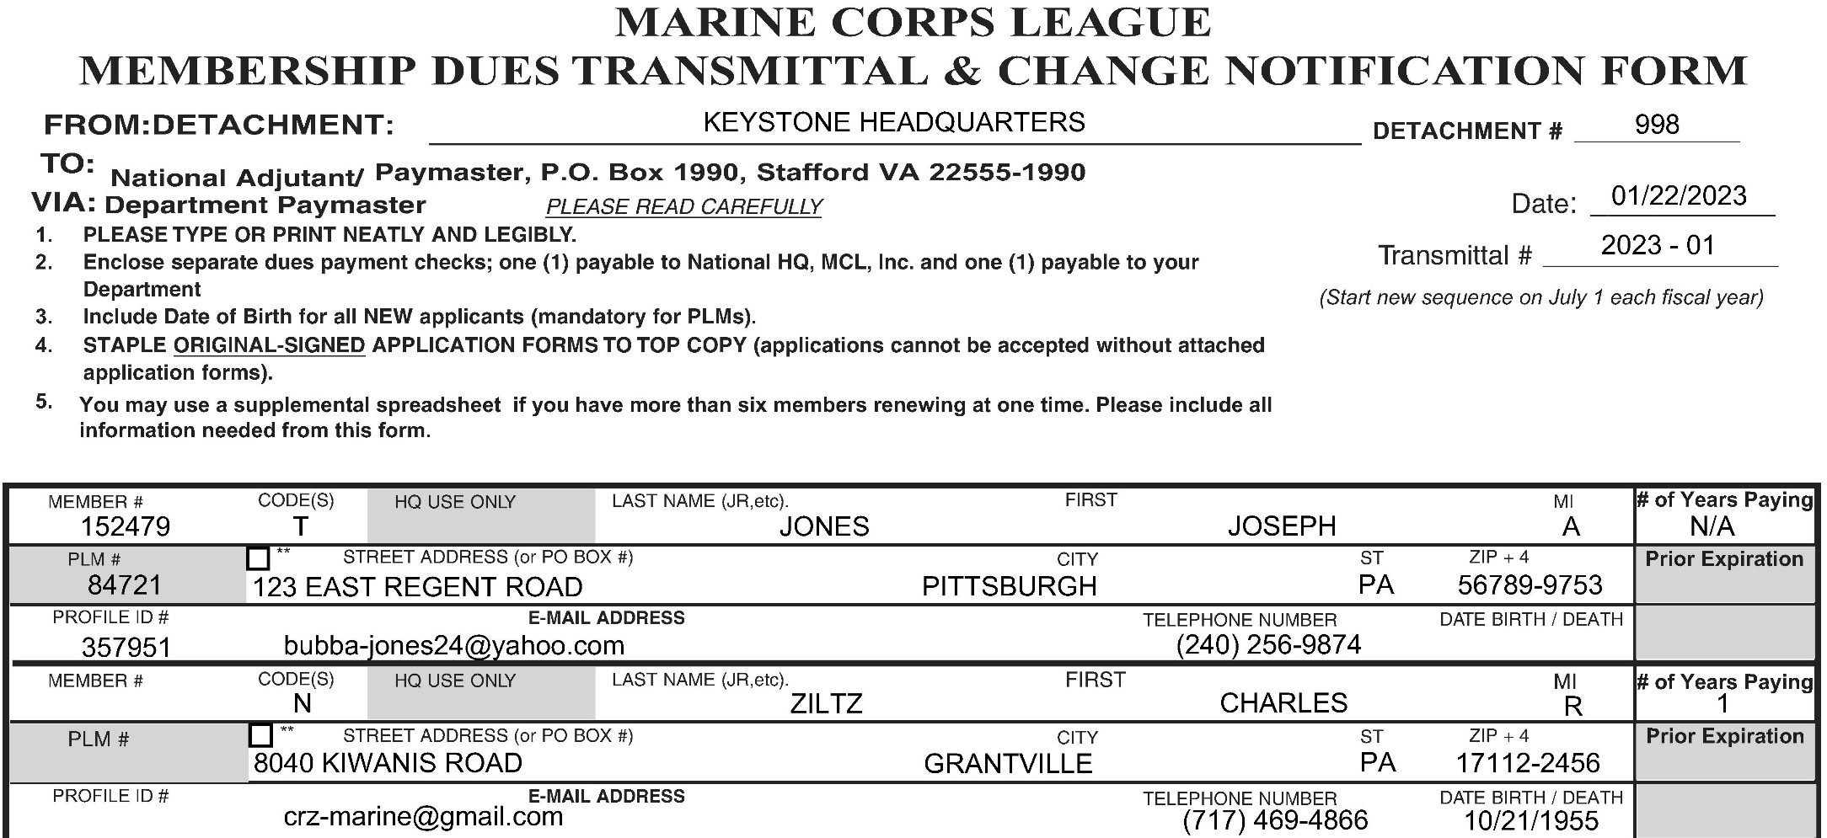
TRANSMITTALS

Slide 28
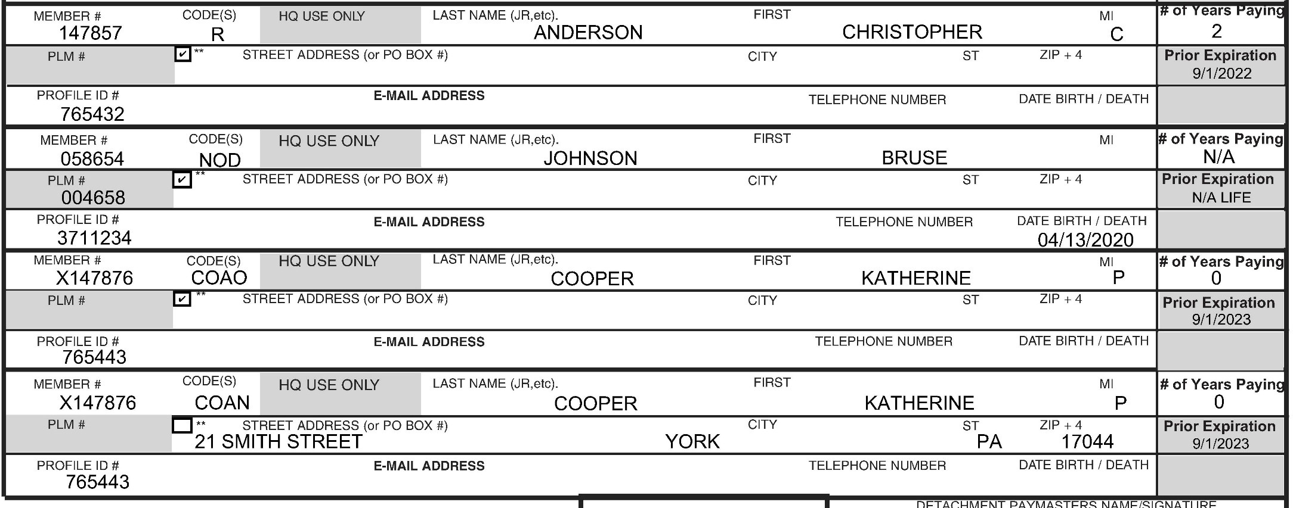
TRANSMITTALS

Slide 29
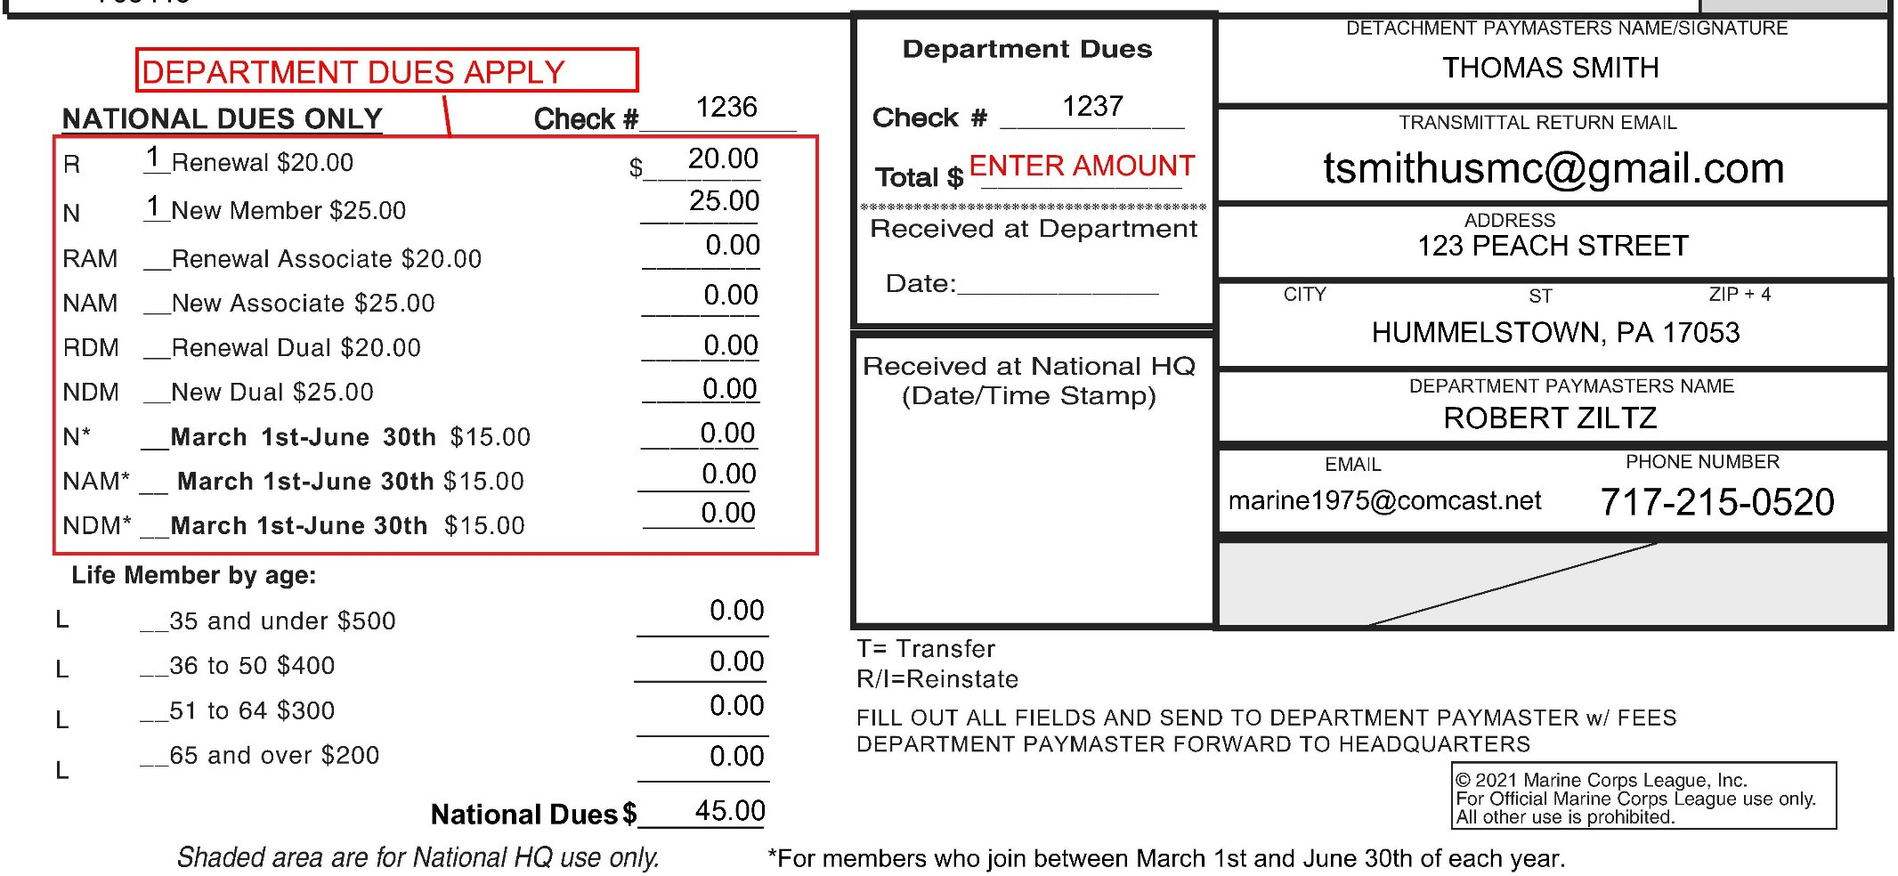
TRANSMITTALS
Only one check containing both National & Department Dues will be sent with the transmittal to the Department Paymaster.

Slide 30
TRANSMITTALS
FINAL COMMENTS
Department Dues are NOT calculated.
Departments need to inform their Detachments what the Department dues are and if there are any differences for new vs renewals. Department dues currently vary widely from Department to Department.
Department of Georgia dues are currently $4.00 per member
No Department dues for new life members (L).
New life member dues MUST be up-to-date when they “go life”. September 1st is the cutoff – cannot submit life member dues after 9/1 without current year dues.

Slide 31
MEMBERSHIP DATABASE
NATIONAL MEMBER DATABASE…
Membership Portal accessible from the Member Library at: https://www.mcleaguelibrary.org/member-library/ Member Library password is “dd4”.
Commandants and Paymasters should get access. Commandant may specify a different officer to replace either one or the other.
Need an email to access Portal. Email is the username. National will assign a password to gain access.
National has posted a series of training videos and PowerPoints in the Member Library. In particular, see:
101_Detachment Database Procedures (PowerPoint PDF)
Video_Database_101_Membership_Portal

Slide 32
MEMBERSHIP DATABASE
NATIONAL MEMBER DATABASE (CONT)…
Using the Portal, Detachment Commandants and Paymasters can:
View all Detachment Member Profiles
Update Member Address, City, State, Zip Code
Update Member Phone Numbers.
Update Member Email Addresses.
Intended to replace COAO/COAN used with Transmittals.
Department Commandants and Paymasters have a higher-level of access using a program called ATLAS. Department can:
Print Rosters at any time.
See profiles of any Detachment / Member in the Department
Search for profiles of specific Members
Run other reports (still in development.)

Slide 33
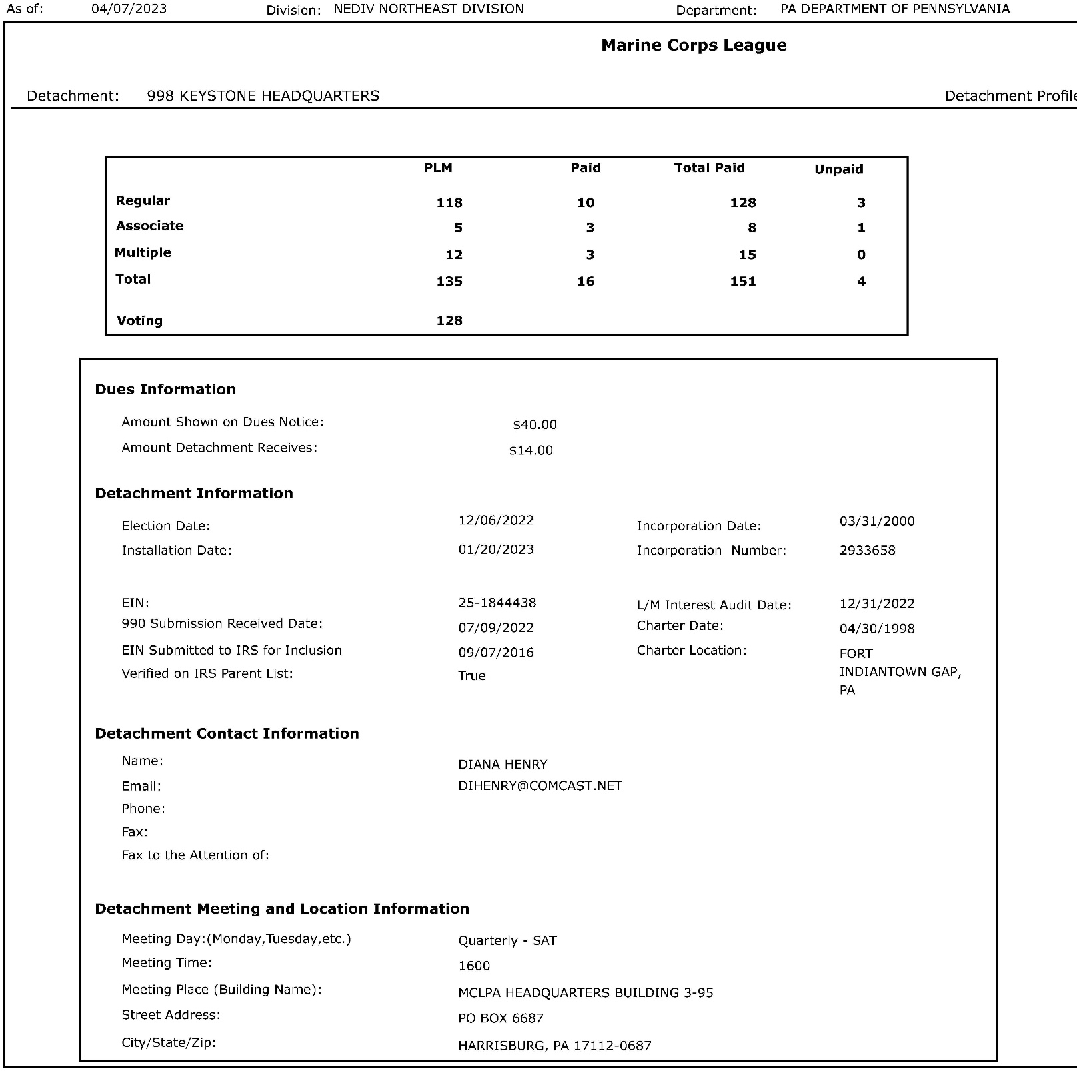
ROSTERS
LAST PAGE

Slide 34
PLM AUDITS
GENERAL COMMENTS
PLM (PAID LIFE MEMBER) AUDITS
MUST be done annually by every Detachment between 1 July and 31 December and submitted not later than 31 December.
Audits done early or late will result in a Detachment losing its PLM distribution. PLM Audits are required by the National BL.
PLM distribution is meant to replace, at least in part, annual dues.
For the 2021-2022 fiscal year, the distribution was $2.54/PLM.
The Audit is nothing more than an internal review of the list of life members in your Detachment confirming that the members listed on your Life Roster are in fact living and not deceased.

Slide 35
PLM AUDITS
GENERAL COMMENTS (CONT)
PLM (PAID LIFE MEMBER) AUDITS
National HQ will provide a special PLM roster in July (usually with the 30 June roster) that must be used for the PLM audit.
To complete the audit, review the provided PLM roster. Deceased members will have a date listed under the “Taps” column. Check each member listing to confirm they are living. If deceased, list the date under the “Taps” column.
If a listing for a member is correct, nothing else is needed.
Any life member not on the list should be added. New life members or transferees, depending on when they became life or transferred in, may not be on the PLM roster.

Slide 36
PLM AUDITS
GENERAL COMMENTS (CONT-2)
PLM (PAID LIFE MEMBER) AUDITS
“Eligible” means the Detachment will receive the distribution for that member. Eligibility starts at the 2nd anniversary of life membership and continues the same after a member passes.
The Audit is prepared by the Paymaster and signed by both the Paymaster and the Commandant.
The PLM distribution is generally made in May of each year, and it is made by Electronic Funds Transfer. To receive their distribution, a Detachment must have checking account information on file with National HQ.

Slide 37
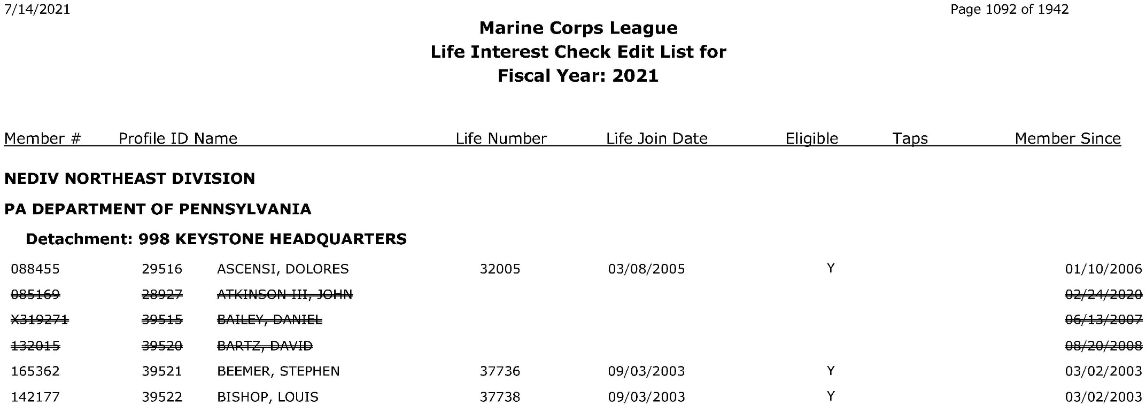
PLM AUDITS
NATIONAL SUPPLIED AUDIT ROSTER - PAGE 1

Slide 38
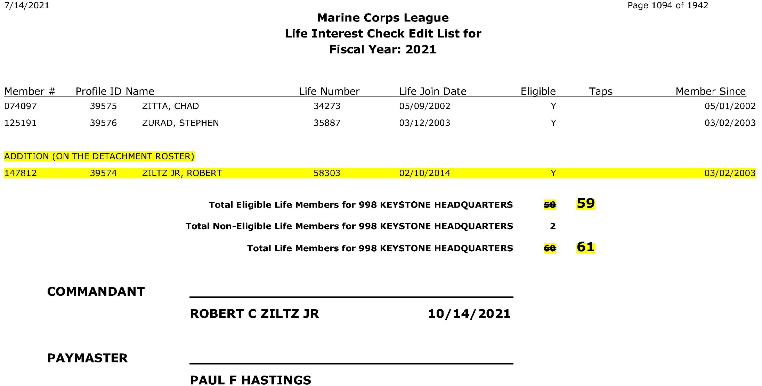
PLM AUDITS
NATIONAL SUPPLIED AUDIT ROSTER – LAST PAGE

Slide 39
IRS 990 RETURNS
BASIC INFORMATION EVERYONE SHOULD KNOW
Detachments are 501c(4) tax Exempt Organizations (E-O) under the MCL IRS Group Exemption 0955. N-BLs permit no exceptions.
All Exempt Organizations MUST file an annual IRS 990 return.
Any E-O that fails to file a 990 for three (3) consecutive years will AUTOMATICALLY have its tax E-O status Revoked.
If a Detachment has its E-O status revoked and continues to operate and raise funds, any monies raised are TAXABLE.
A Detachment that becomes Revoked may lose its Charter – either temporarily or permanently – and will be forced to stop all activities under the guise of the Marine Corps League.
Departments are responsible for monitoring the exempt status of their Detachments and to take corrective action as appropriate.

Slide 40
IRS 990 RETURNS
990 BASICS
Due Dates
Date depends on the end of the fiscal year. All Detachments must use a 1 July-30 June fiscal year. The 990 return is due 4 ½ months after the close of the fiscal year:
1 July to 30 June FY – 990 is due 15 November and can be filed starting on July 1, the day after the fiscal year ends.
Late returns can still be filed – there is no penalty for filing late, only for not filing at all. If the filing is missed when due, file it as soon as it can be done.

Slide 41
IRS 990 RETURNS
990 BASICS
Types of Returns
There are 4 types of 990 returns:
Form 990 (paper return) analogous to IRS Form 1040
Form 990 EZ (paper return) analogous to IRS Form 1040 EZ
Form 990 PF (paper return) applies only to private foundations
Form 990 N (electronic “postcard”) This is the easiest method
The choice of form is based on the amount of money raised by the organization filing the return. Most Detachments will file a 990 N.
The 990 N limits are based on gross revenue from all sources. General guidelines are that if a Detachment has less than $50,000 in revenue, it can file a 990 N return.

Slide 42
IRS 990 RETURNS
990 BASICS
Revenue Requirements (From the IRS Website)
Small E-Os are generally eligible to file Form 990-N if their annual gross receipts are normally $50,000 or less.
Gross receipts are the total amounts the organization received from all sources without subtracting any costs or expenses.
Gross receipts are normally $50,000 or less if:
Is at least 3 years old and averaged $50,000 or less in gross receipts for the immediately preceding 3 tax years (including the year for which calculations are being made).
For more information, see the IRS website.

Slide 43
IRS 990 RETURNS
FILING A 990-N RETURN
Filing a 990 N
https://www.irs.gov/charities-non-profits/annual-electronic-filing- requirement-for-small-exempt-organizations-form-990-n-e-postcard
Create a user account (see above site)
Need your Detachments EIN and Fiscal Year.
Login after the close of your Fiscal Year.
Follow the screens and file your 990 N. Takes less that 15 minutes.
AFTER THE RETURN IS ACCEPTED, print a copy of the acceptance and mail it to National HQ thru the Dept. Paymaster.
National must track and update the Detachments operation under Group 0955 and uses the information to validate the Group list.

Slide 44
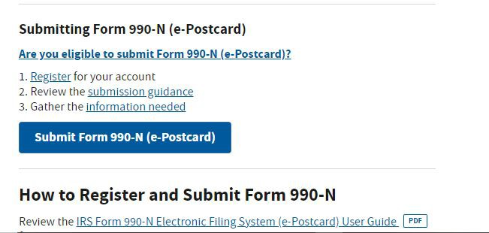
IRS 990 RETURNS
Using the link to the 990N info page on the IRS website, scroll down to…

Slide 45
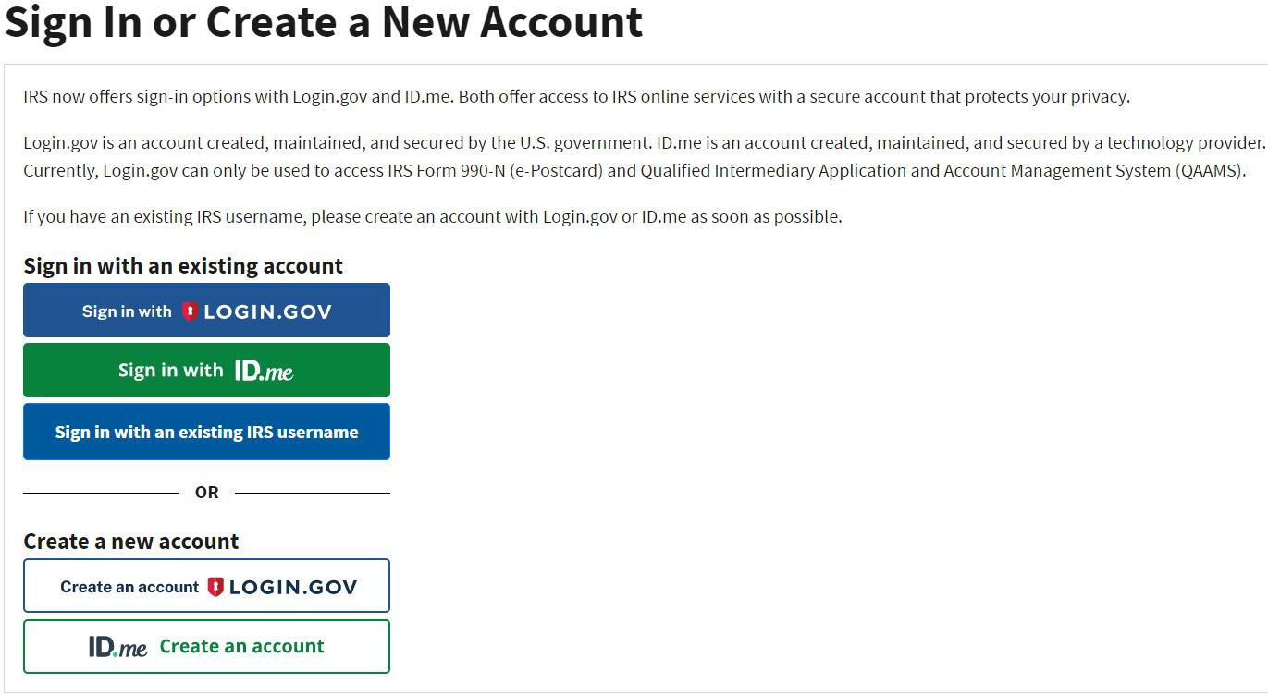
IRS 990 RETURNS
The IRS990 System Login changed at the end of 2022. Users now have the option of how they login to the system – either LOGIN.GOV or ID.me. Either will work, however, users have no choice as the old login only works a limited number of times and forces the user to switch over to a login under one of these two new choices.

Slide 46
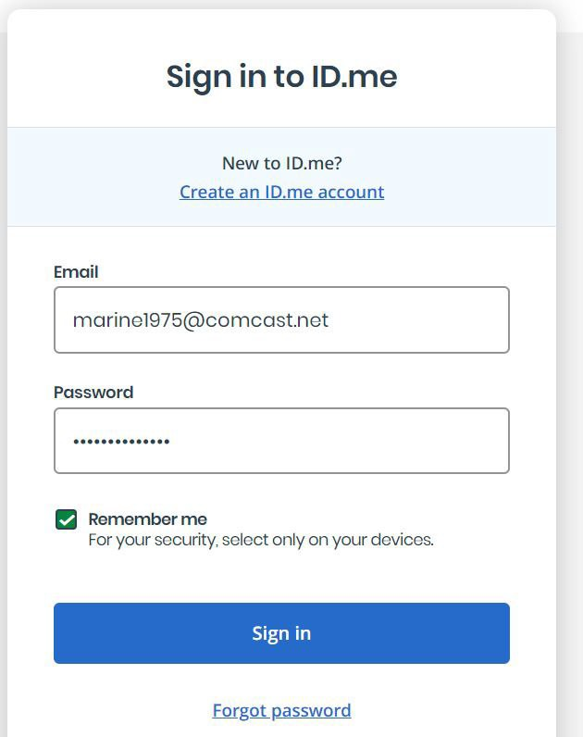
IRS 990 RETURNS
Shown is the login screen for ID.me. This system uses a two-step identification when logging in.
After logging in, the user is taken to the same screen as with the old login system and chooses between managing their profile or managing previous 990 submissions.

Slide 47
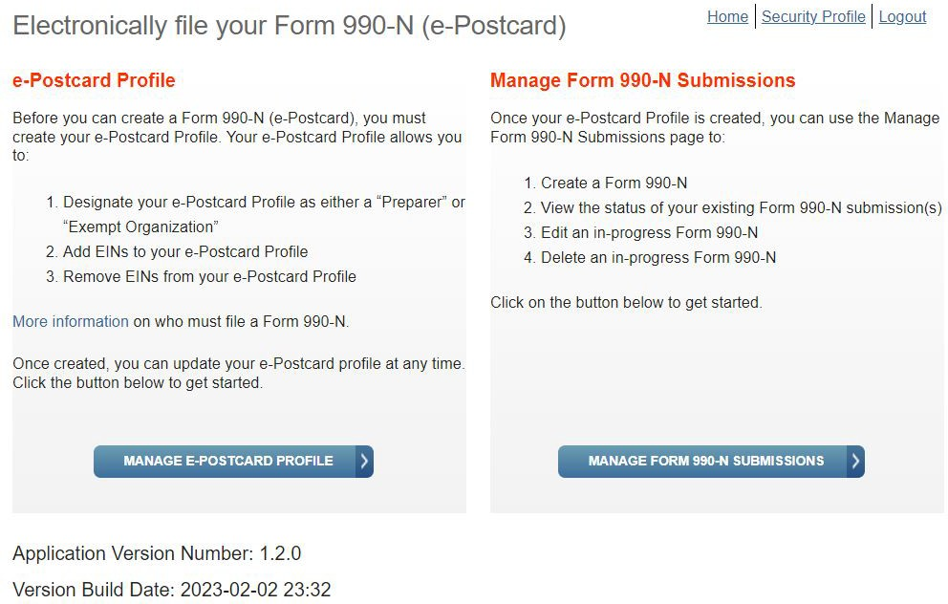
IRS 990 RETURNS
There are 2 paths to create a new 990-N. Click on either “MANAGE PROFILE” or “MANAGE SUBMISSIONS”

Slide 48
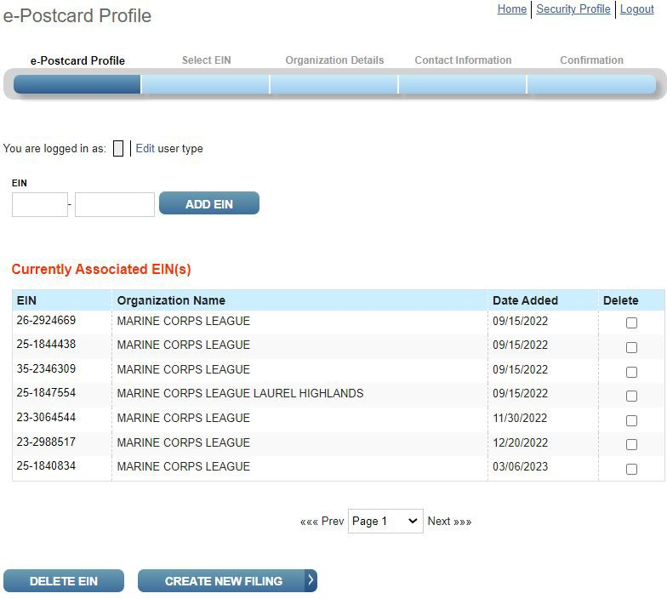
IRS 990 RETURNS
Clicking on “MANAGE PROFILE” brings up this page.
Make sure that the EIN you are creating a new 990-N for appears in the list below.
If not, enter it in the fields to the left and click “ADD EIN.” Then click on “CREATE NEW FILING.”

Slide 49
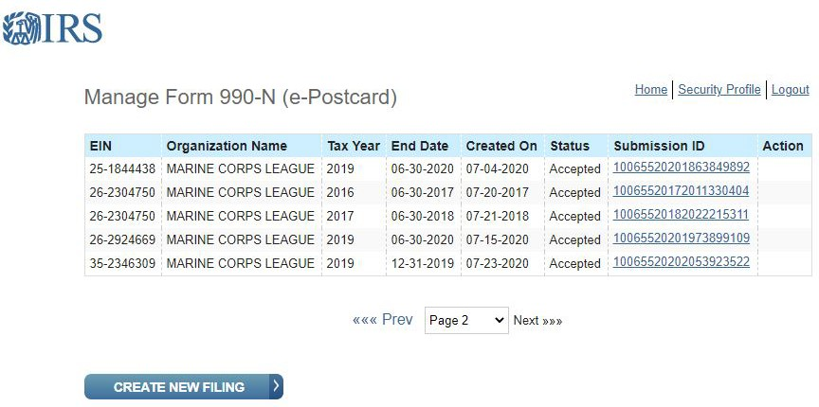
IRS 990 RETURNS
Clicking on “MANAGE SUBMISSIONS” brings up this page.
To create a new 990-N and submit it, click on the “CREATE NEW FILING” button at the bottom of the page.

Slide 50
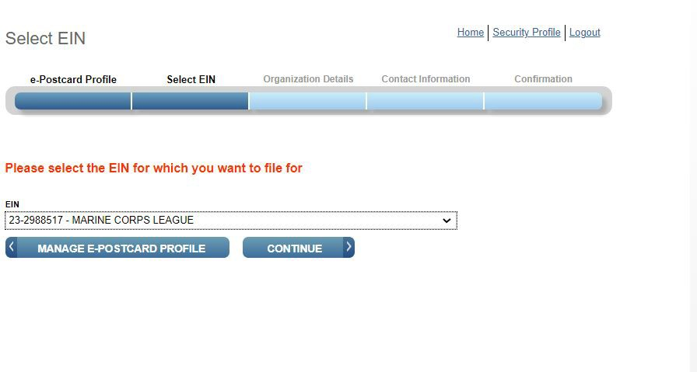
IRS 990 RETURNS
Clicking on “CREATE NEW FILING” on either the “MANAGE PROFILE” or “MANAGE FORM” pages
brings you to this page.
Select the EIN you are filing the 990-N for from the drop- down list. Then hit “CONTINUE.”

Slide 51
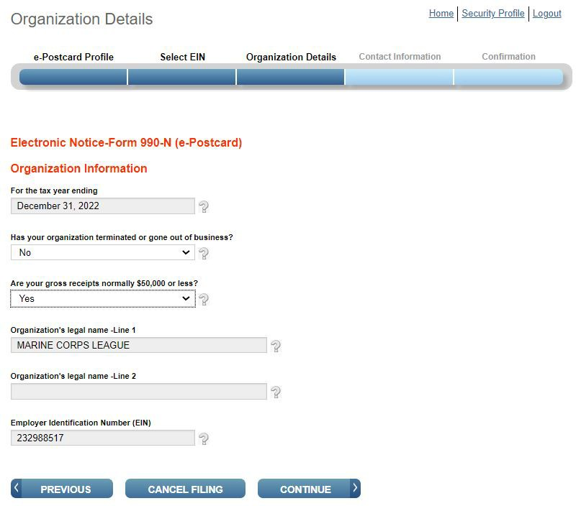
IRS 990 RETURNS
The actual 990 data that is needed to submit a return is shown on this and the next two slides.
Fill in the blanks and answer the two questions:
Are you going out of business? And
Are your gross receipts normally $50,000 or less?

Slide 52
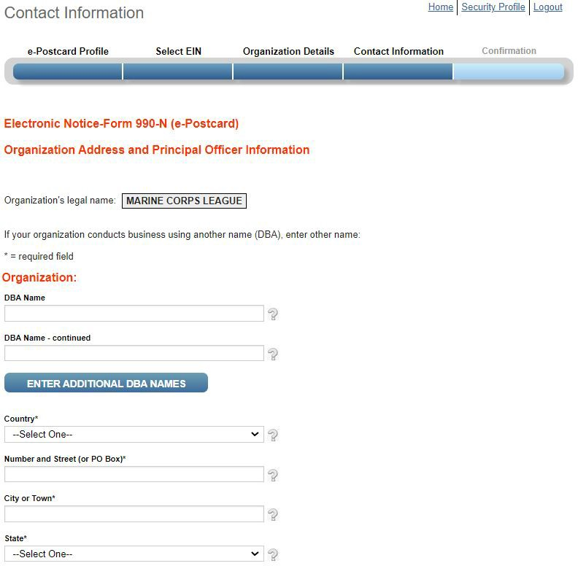
IRS 990 RETURNS
These fields are for the Detachments DBA name. This is the Detachment Name.
Remember, all Detachments and Departments are under Group 0955, which means all have the legal name “MARINE CORPS
LEAGUE” in the eyes of the IRS.
Also enter your mailing address and additional DBA Names as needed.

Slide 53
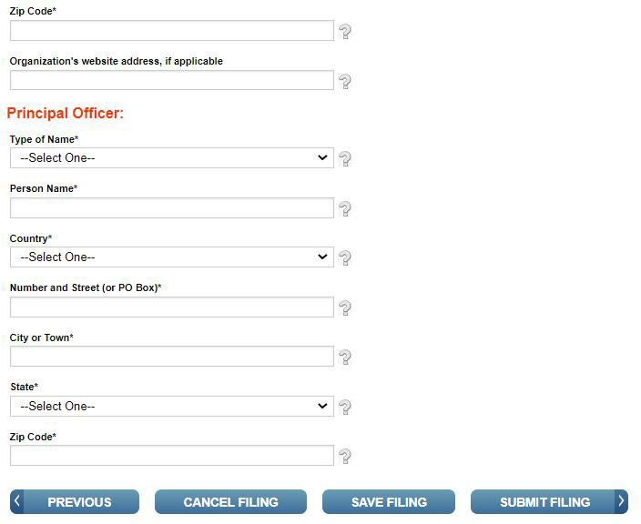
IRS 990 RETURNS
These fields are for contact information for the principal officer of your Detachment. Usually, this is either the Commandant or the Paymaster.
The address can be the same address as entered for the Detachment.
When this page is filled in, click “SUBMIT FILING”.
The 990 submission is then complete.

Slide 54
IRS 990 RETURNS
After submitting a 990, you should return to “MANAGE SUBMISSIONS” page. After 7 or 8 minutes, the status of the submission you just made will change to “Accepted.”
To see and print the acceptance for the new submission, or for any old submission listed, click on the Submission ID. The Submission ID is a hot-link and will bring up the acceptance.

Slide 55
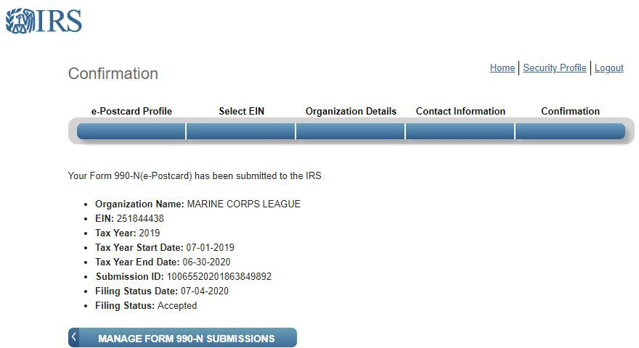
IRS 990 RETURNS
Clicking on a Submission ID brings up the Confirmation which will look like the one below.
This is what should be sent into National HQ through the Department Paymaster once the status is “Accepted.”

Slide 56
FINAL COMMENTS
A Few Recommendations for Detachment Paymasters…
Keep Records! Financial records, rosters, PLMs & transmittals all can be useful when trying to solve a problem.
Use a computer – avoid filling out forms by hand.
Know and understand the Bylaws and how to apply them.
Use the Chain-of-Command. The Department Paymaster can help!
Stay in compliance with 990s and PLMs. It is much easier to stay in Good Standing than it is to correct a revocation.
Be open and transparent with the members of your Detachment.

